Slide 1
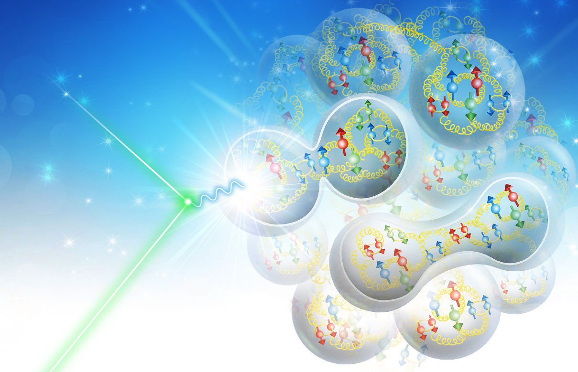
Electron-Ion Collider Accelerator Design Status
for JLEIC and eRHIC design teams
Vasiliy Morozov
Jefferson Lab
13th European Research Conference
on Electromagnetic Interactions with Nucleons and Nuclei
27 October – 2 November, 2019, Paphos, Cyprus

Slide 2
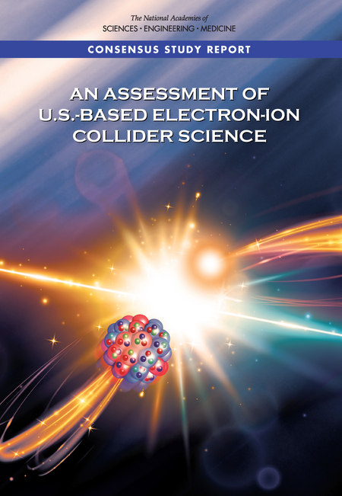
2018 Report of National Academy of Sciences, Engineering, and Medicine*
“In summary, the committee finds a compelling scientific case
for such a facility. The science questions that an EIC will answer
are central to completing an understanding of atoms as well as
being integral to the agenda of nuclear physics today. In addition,
the development of an EIC would advance accelerator science and
technology in nuclear science; it would as well benefit other fields
of accelerator based science and society, from medicine through
materials science to elementary particle physics.”
Topics specifically identified in the NAS report as being the main
program of research at the EIC are the emergences of
  mass of nucleons,
  spin of the nucleons,
  properties of dense system of gluons from underlying QCD interactions.
* National Academies of Sciences, Engineering, and Medicine. 2018. An Assessment of U.S.-Based Electron-Ion Collider Science. Washington, DC: The National Academies Press. https://doi.org/10.17226/25171.

Slide 3
Electron Ion Collider Requirements
Established in Community White Paper*, re-emphasized in 2015 NSAC LRP, and NAS study
Polarized (~70%) electrons, protons, and light nuclei
  High polarization essential to physics and delivering it in a timely manner
  For many measurements statistical uncertainty ~ 1/( L x P_{e}² x P_{p}² ) ^{1/2}
Ion beams from deuterons to the heaviest stable nuclei
  Protons, deuterons, light nuclei, through U or Pb
Variable center of mass energies ~20-100 GeV, upgradable to ~140 GeV
  Not a collider to achieve highest possible CoM energy
  Highest luminosity demands in mid energy range
High collision luminosity ~10³³⁻³⁴ cm⁻² s⁻¹
  “Factory”-like luminosity, factor of 100-1000 beyond HERA
Possibility of more than one interaction region
*A. Accardi et al. , “Electron Ion Collider: The Next QCD Frontier - Understanding the Glue that Binds Us All”, Eur. Phys. J. A52 , p. 268 (2016), https://doi.org/10.1140/epja/i2016-16268-9

Slide 4
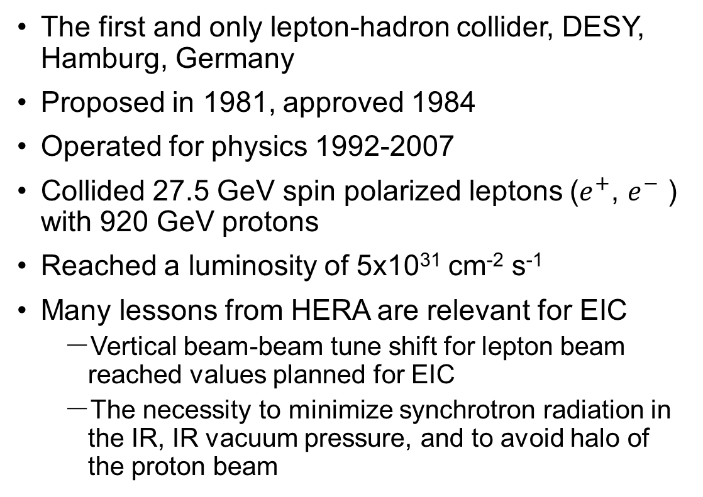
HERA
The first and only lepton-hadron collider, DESY, Hamburg, Germany
Proposed in 1981, approved 1984
Operated for physics 1992-2007
Collided 27.5 GeV spin polarized leptons ($e^{+}$, $e^{−}$ ) with 920 GeV protons
Reached a luminosity of 5x10³¹ cm⁻² s⁻¹
Many lessons from HERA are relevant for EIC
  Vertical beam-beam tune shift for lepton beam reached values planned for EIC
  The necessity to minimize synchrotron radiation in the IR, IR vacuum pressure, and to avoid halo of the proton beam
F. Willeke, “HERA and the Next Generation of Lepton-Ion Colliders”, in Proc. of EPAC'06 , Edinburgh, paper FRXBPA01

Slide 5
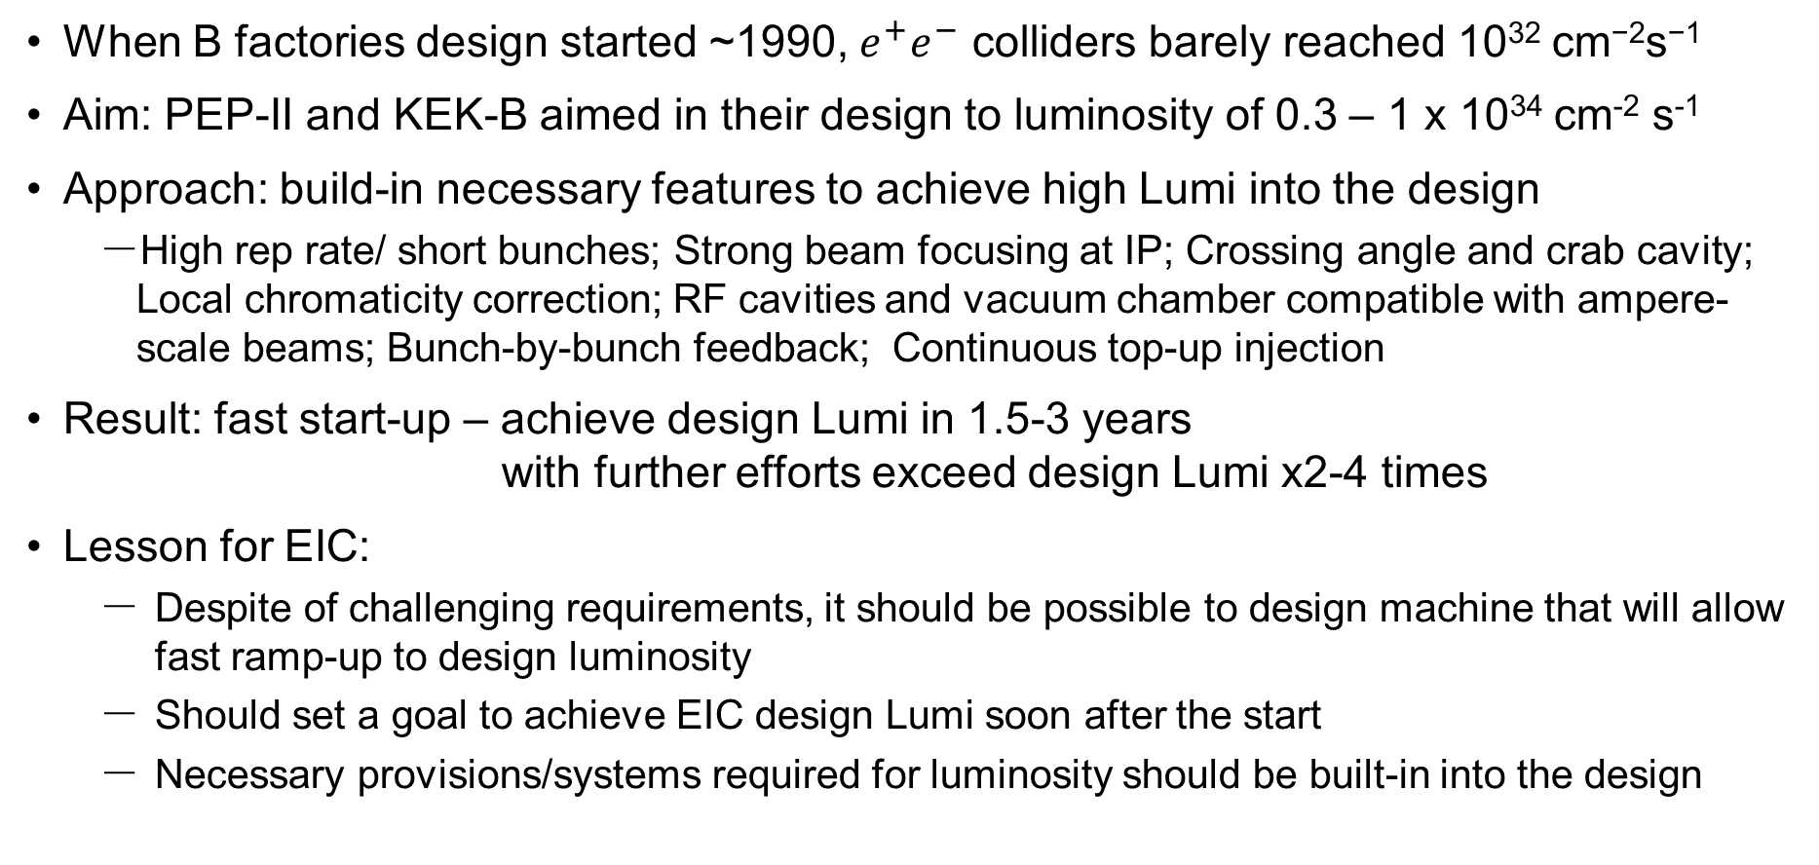
Lessons from B Factories - KEK B and PEP-II
When B factories design started ~1990, $e^{+}e^{−}$ colliders barely reached 10³² cm⁻²s⁻¹
Aim: PEP-II and KEK-B aimed in their design to luminosity of 0.3 – 1 x 10³⁴ cm⁻² s⁻¹
Approach: build-in necessary features to achieve high Lumi into the design
  High rep rate/ short bunches; Strong beam focusing at IP; Crossing angle and crab cavity; Local chromaticity correction; RF cavities and vacuum chamber compatible with ampere-scale beams; Bunch-by-bunch feedback; Continuous top-up injection
Result: fast start-up – achieve design Lumi in 1.5-3 years
with further efforts exceed design Lumi x2-4 times
Lesson for EIC:
  Despite of challenging requirements, it should be possible to design machine that will allow fast ramp-up to design luminosity
  Should set a goal to achieve EIC design Lumi soon after the start
  Necessary provisions/systems required for luminosity should be built-in into the design

Slide 6
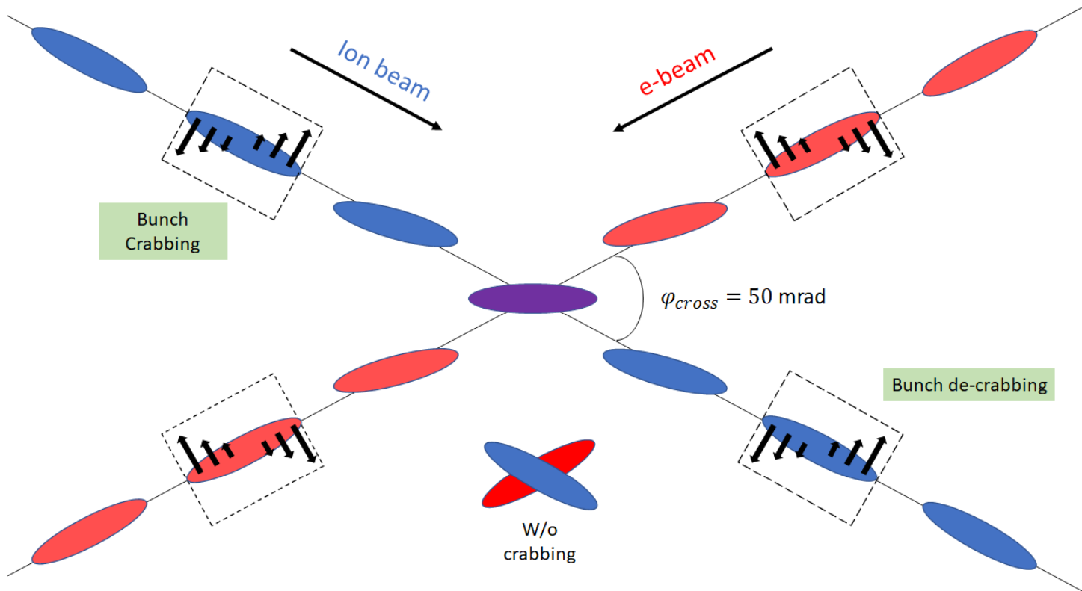
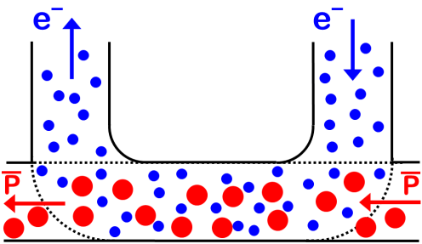
EIC Design Features Enabling High Luminosity and High Polarization
High repetition rate
  Short bunches allow for strong focusing at the IP
Crossing angle and crab cavities
  Enables high rep rate, control background
Hadron beam cooling
  Combat Intra-Beam Scattering, reduce and preserve emittance
Use of Siberian snakes or figure-8 topology
  Preserve high polarization of beams
IBS
Factor γ in Δp

Slide 7
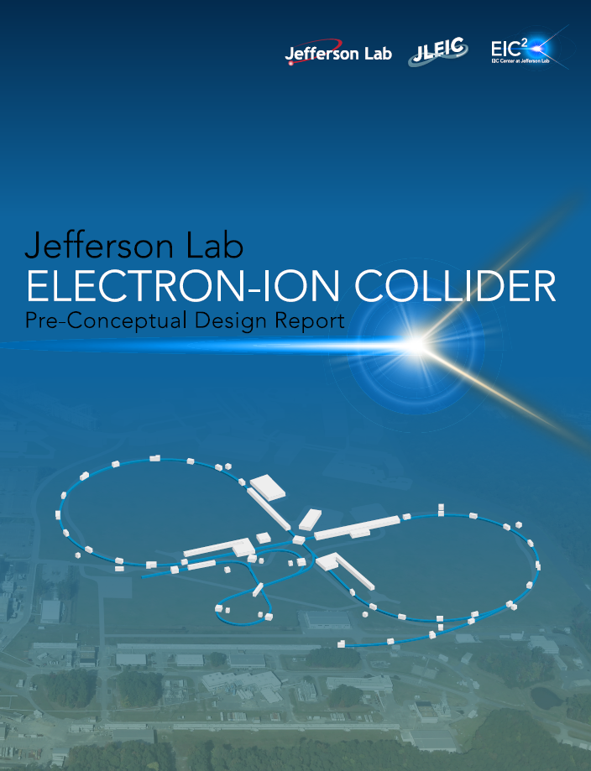
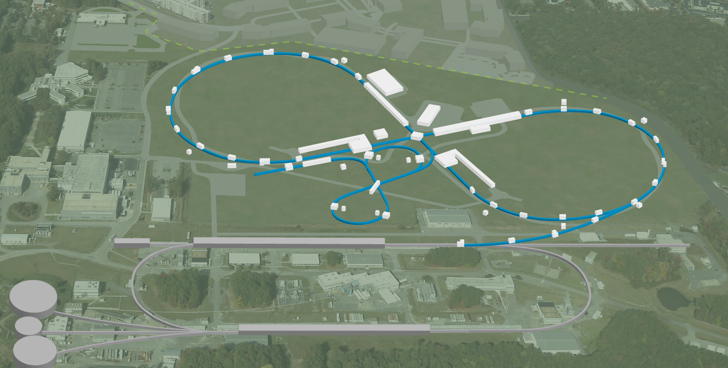

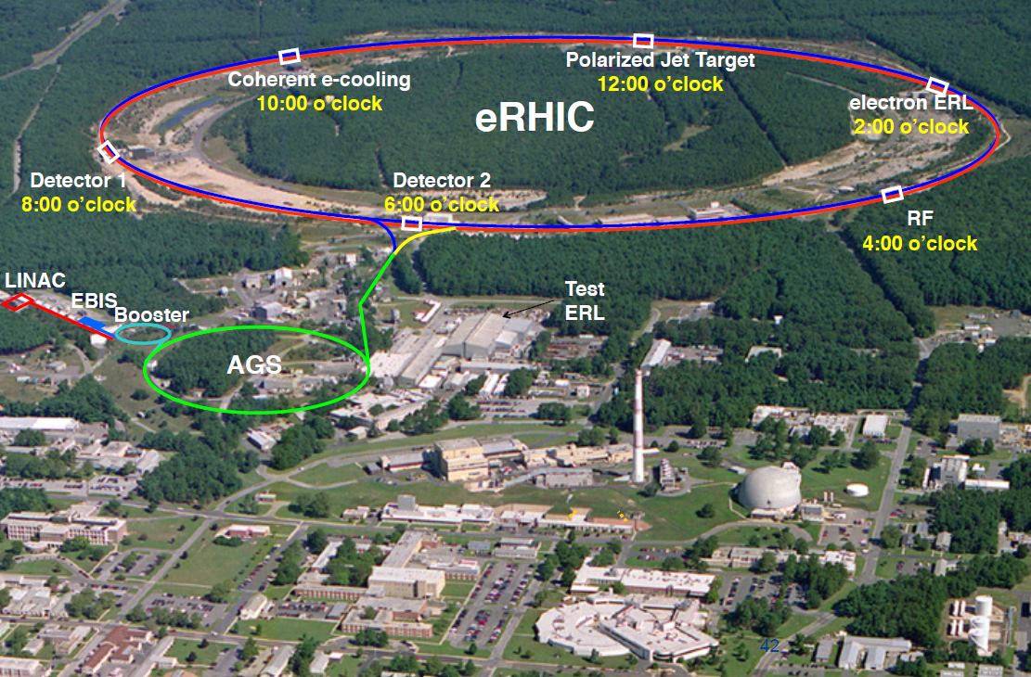
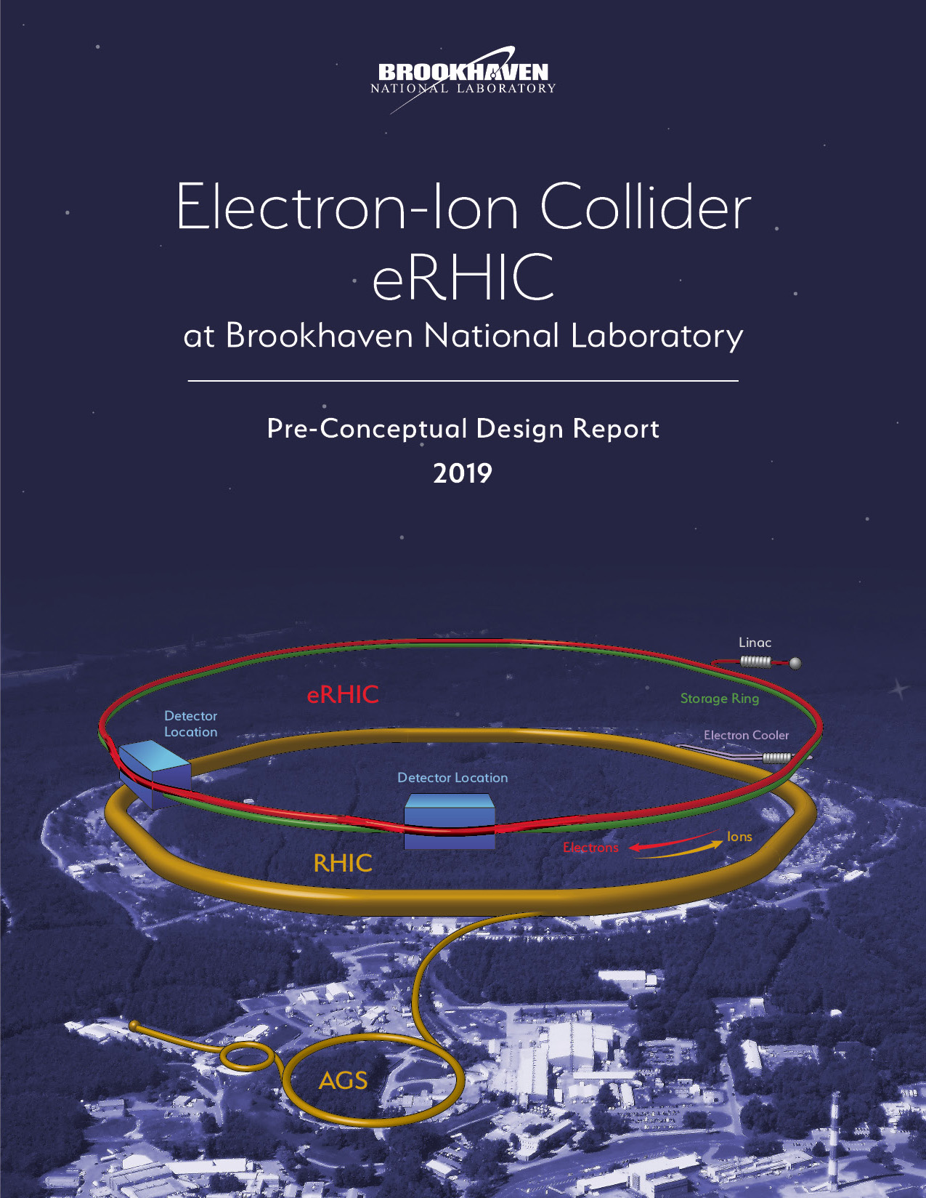
EIC Designs
ELECTRON-ION COLLIDER
JEFFERSON LAB
Artist’s Conception
Both EIC concepts designed to meet the requirements set forth in NSAC Long Range Plan, which was emphasized by the NAS report:
Highly polarized (~70%) electron and nucleon beams
Ion beams from deuterons to the heaviest nuclei (uranium or lead)
Variable center of mass energies from ~20 - ~100 GeV, upgradable to ~140 GeV
High collision luminosity ~10³³ – 10³⁴ cm⁻²s⁻¹
Possibilities of having more than one interaction region
Both designs based on ring-ring approach, both benefit from existing Nuclear Physics infrastructure and are based on the same accelerator principles:
Electron Storage Rings with frequent injection of fresh polarized beams
Hadron storage rings with strong cooling or alternatively frequent injections
CEBAF
Accelerator R&D going on with strong cooperation between several DOE labs under DOE NP stewardship
Brookhaven Lab
Long Island, NY

Slide 8

eRHIC Layout
Hadrons up to 275 GeV
  eRHIC is based upon the existing RHIC complex:
  Storage ring (Yellow Ring), injectors,
  ion sources, infrastructure
  Need only few modifications for eRHIC
  Today’s RHIC beam parameters are close
  to what is required for eRHIC
Electrons up to 18 GeV
  Electron storage ring with up to 18 GeV ➔ E_{cm} = 20 GeV -141 GeV installed in RHIC tunnel.
  Beam current are limited by the choice of installed RF power 10 MW
  Electron beams with a variable spin pattern accelerated in the on-energy, spin transparent injector: Rapid Cycling Synchrotron with 1-2 Hz cycle frequency in the RHIC tunnel
  Polarized electron source and 400 MeV s-band injector linac in existing tunnel
  Design meets the high luminosity goal of L = 10³⁴cm⁻²s⁻¹

Slide 9
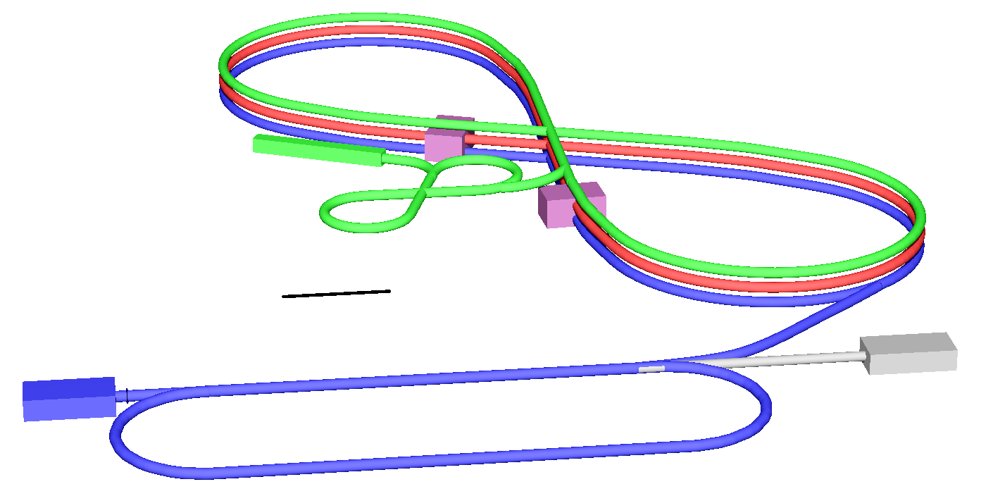
JLEIC Layout
Full-energy top-up injection of highly
polarized electrons from CEBAF ⇒
High stored electron current and polarization
Full-size high-energy booster ⇒
Quick replacement of colliding ion beam ⇒
High average luminosity
High-rate collisions of strongly-focused short
low-charge low-emittance bunches
similarly to record-luminosity lepton colliders ⇒
High luminosity
Multi-stage electron cooling using
demonstrated magnetized cooling
mechanism ⇒ Small ion emittance ⇒
High luminosity
Figure-8 ring design ⇒ High electron and ion polarizations, polarization manipulation and spin flip
Integrated full acceptance detector with far-forward detection sections being parts of both machine and detector
Upgradable to 140 GeV CM by replacing the ion collider 6T NbTi cosθ bending dipoles only with 12 T Nb3Sn magnets
13 GeV/c
High energy
Booster
Interaction
point
200 GeV/c
Ion collider ring
150 MeV Ion linac
Interaction
point
Low energy
8.9 GeV/c Booster
100m
3-12 GeV/c
Electron collider ring
Electron source
12 GeV CEBAF
Design meets the high luminosity goal of L = 10³⁴cm⁻²s⁻¹

Slide 10
High Luminosity Implementation
Since both JLEIC and eRHIC designs are storage-ring-based designs,
the same ingredients are required for high luminosity
Relatively large bunch charge for bunch emittance and length
(yet small in comparison with hadron colliders)
Many bunches ➔ large total beam currents
➔ crossing angle collision geometry
Small beam size at collision point achieved by
* small emittance
➔ small hadron emittance
* and strong focusing at IR (small β)
➔ requires short bunches
Luminosity limits vs E: Space Charge, Beam-Beam Limits, Synchrotron Radiation
➔ requires strong hadron cooling or frequent injection of pre-cooled beam

Slide 11
EIC Luminosity
EIC designs baselines
EIC designs peak luminosity
JLEIC upgrade with 12T Nb₃Sn dipoles
10³⁴
10³⁴
10³⁴
Luminosity limits:
Beam-beam
eRHIC 2nd IR optimized for high luminosity at 63 GeV CM
10³³
10³³
Space-charge
10³³
Synch. Rad.
10³²
10³²
10³²
Relation of the peak luminosity to the average one varies with CM energy and operational assumptions

Slide 12
EIC Parameters
for one selected energy for each case shown in the Luminosity plot
L_{ave} numbers with * are without strong cooling

Slide 13
Strong Hadron Cooling and High Luminosity
For high luminosity operation of the EIC strong hadron cooling is desirable if not necessary to avoid rapid decay of the luminosity caused by emittance blow-up due to intrabeam scattering
The two designs aimed to optimize luminosity at different ranges of hadron energy and the cooling systems are optimized accordingly
JLEIC uses a multi-turn incoherent magnetized bunched electron beam cooling ring fed by an energy recovery linac and using a circulator ring to balance IBS growth time between ~10 and ~40 minutes. This cooling increases the luminosity at lower energies.
eRHIC has IBS growth rates of ~25 min to ~2 h for highest luminosity. It uses micro-bunched coherent electron cooling.

Slide 14
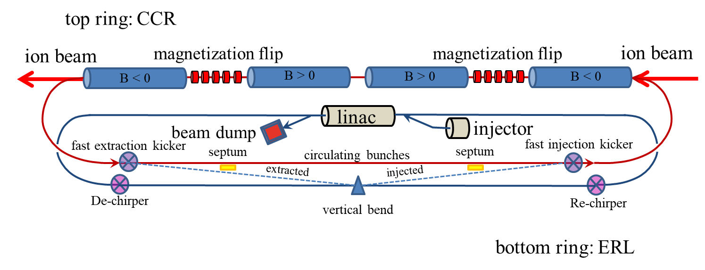
Strong Incoherent Hadron Cooling Scheme for JLEIC
Magnetized electron beam for higher cooling efficiency
Cooling electron beam is energy-recovered to minimize power consumption
11-turn circulator ring with ~1 A beam current relaxes electron source and ERL current requirements
Fast harmonic kicker to kick electrons in and out of the circulator ring
Pre-cooling at low energy is essential to achieve the anticipated performance

Slide 15
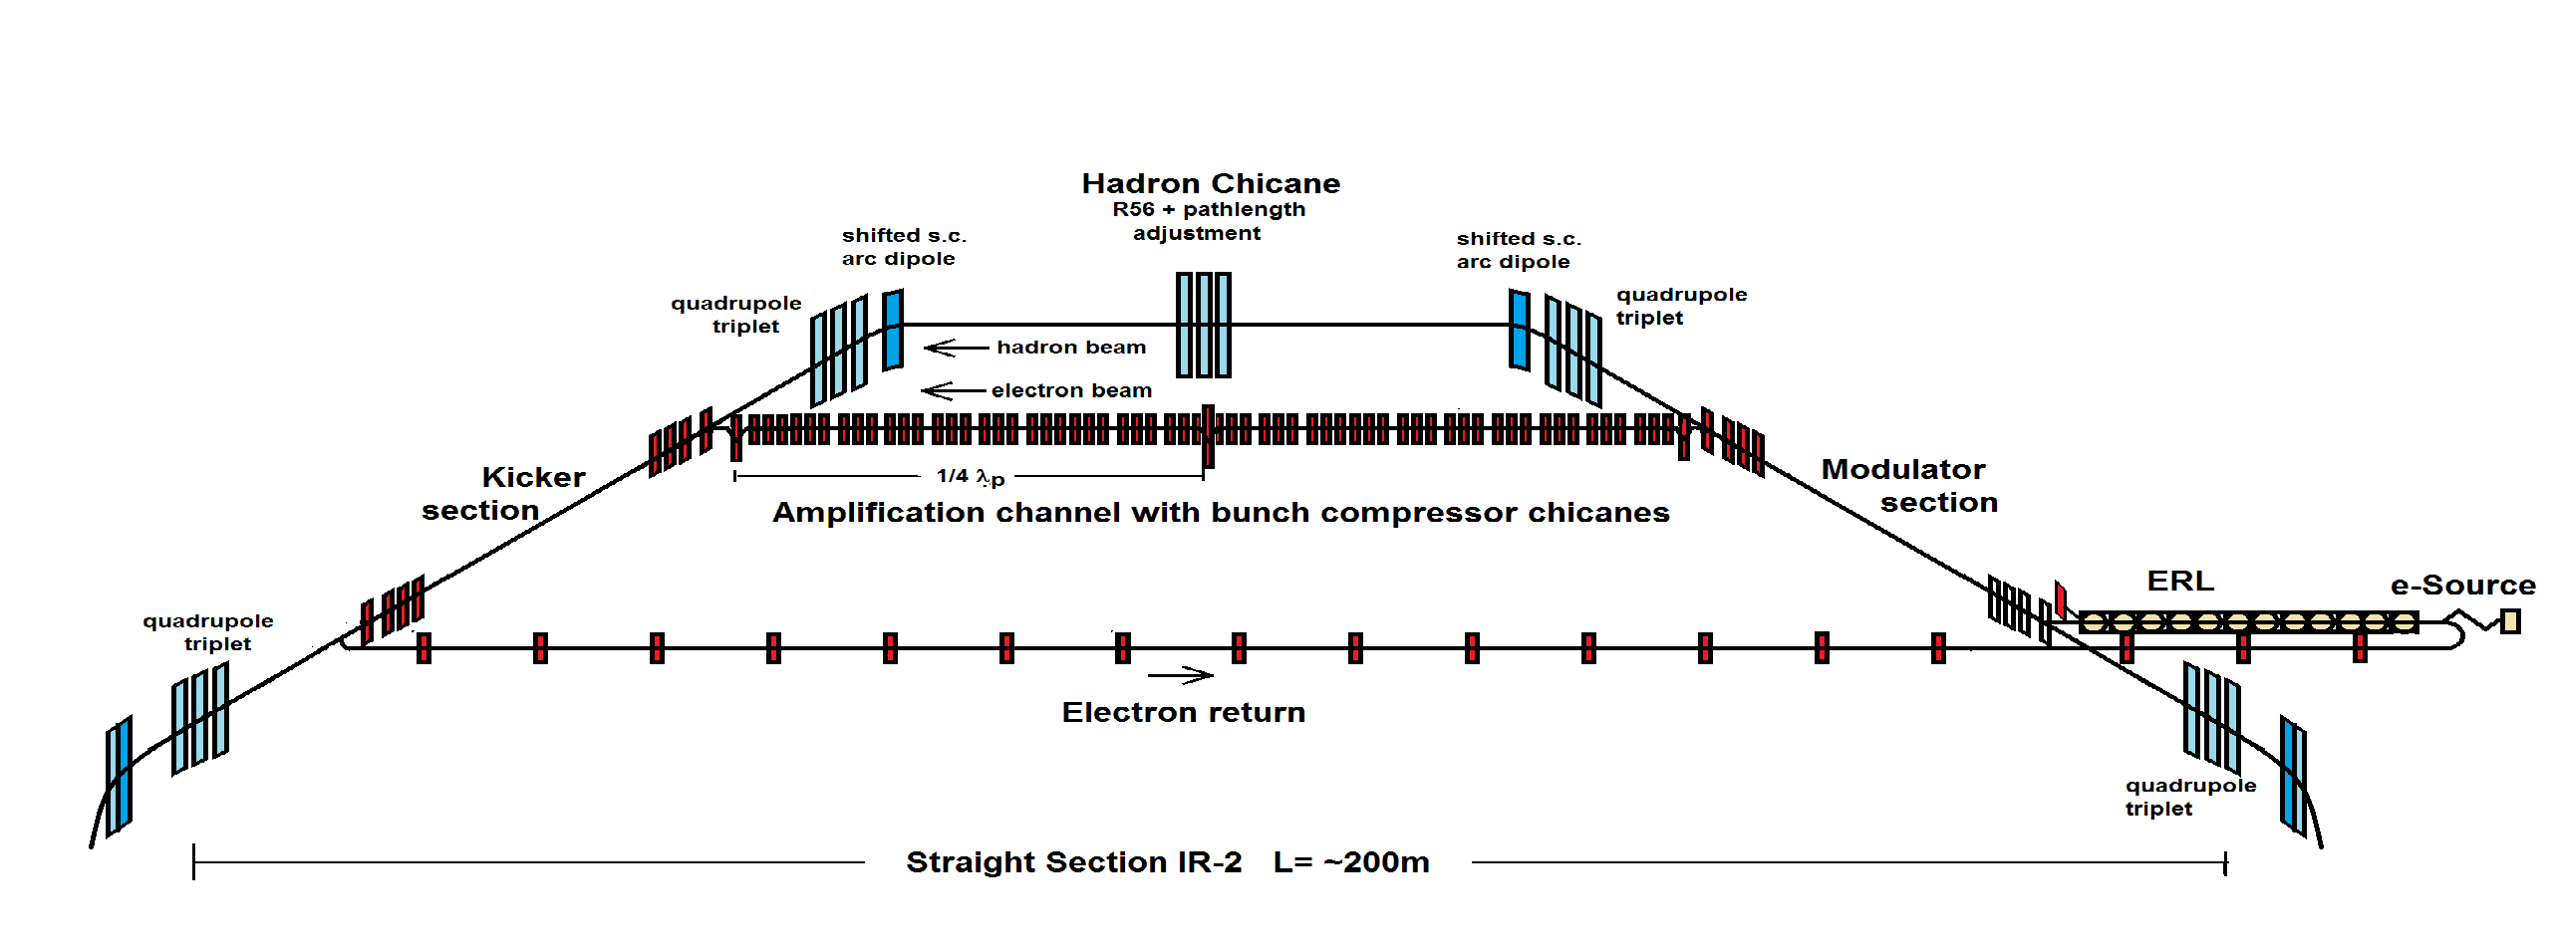
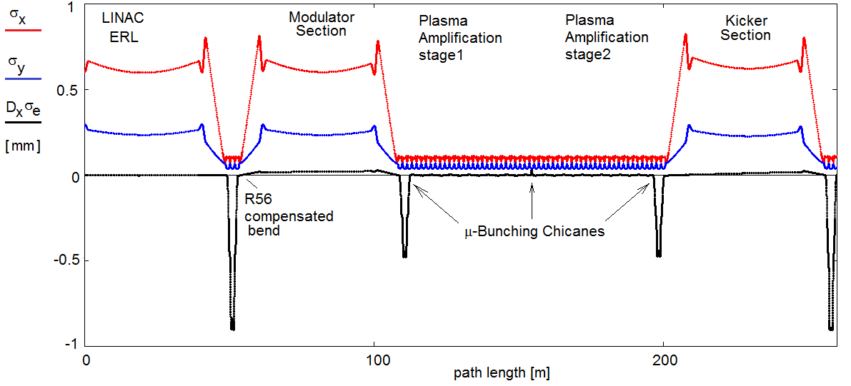
Strong Coherent Hadron Cooling Scheme for eRHIC
Coherent Electron Cooling with micro-bunching amplification
Electron Beam Optics
Micro-bunched cooling is a novel scheme based on available technology
Strong cooling as desirable but not necessary for high luminosity (especially high average luminosity)
Similarly to the JLEIC scheme, this option requires electron cooling at low energy
Strong cooling is not necessary as the hadron beam could be replaced frequently on-energy using the existing second ring of present RHIC

Slide 16
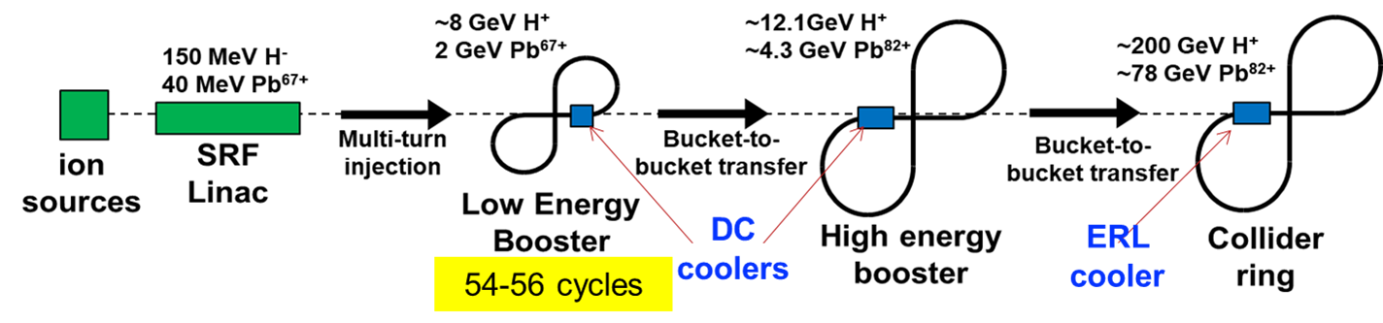
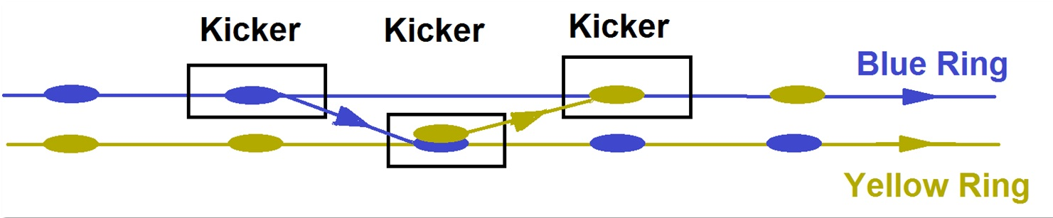
Alternative to Strong Hadron Cooling in eRHIC and JLEIC
JLEIC maximum and ave. luminosity of 1·10³⁴ cm⁻²s⁻¹
does not depend on the feasibility of strong hadron cooling
  The full size booster of JLEIC can be used for hourly
  injection of beam pre-cooled by a conventional DC
  electron cooler
eRHIC maximum luminosity of 1·10³⁴ cm⁻²s⁻¹ does not depend on the feasibility of strong hadron cooling
  Since RHIC has a second superconducting ring, the Blue Ring, on-energy injections into the collider ring, the Yellow Ring will replace the hadron bunches after one hour of storage
  Transfer takes 13 μs and will preserve the total charge in both machines, no transient injection effect
  The emittance growth between injections is small, allowing L_{ave} of 0.93·10³⁴ cm⁻²s⁻¹ to be achieved
  The required small vertical ε_{Ny} = 0.5 μm will be achieved with standard DC electron beam cooling in the AGS
  No new hardware for spin transparency is required
  Next steps: Developing details of Blue ring by-passes in detector areas and the pre-cooler scheme. Better assessment of the scheme cost.

Slide 17
EIC Polarization Requirements
High electron and hadron polarization of over 70%
  Required polarized electron and ion sources within the state of the art
  Preservation of polarization during acceleration using tune jumps, Siberian snakes, figure-8 topology, spin transparency, etc.
Long polarization lifetime: small change of polarization during a store
  Full-energy top off of the stored electron beam with highly polarized electrons
  Suppression of spin tune spread and avoidance of spin resonances for ions
Polarization orientation at the IP
  Longitudinal polarization for electrons
  Both transverse and longitudinal directions adjustable for hadrons
Suppression of systematic effects
  Bunches with different polarization directions stored at the same time
  Spin flipping

Slide 18
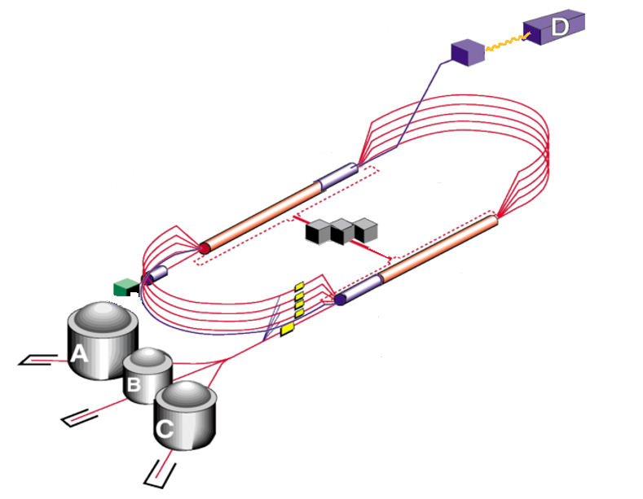
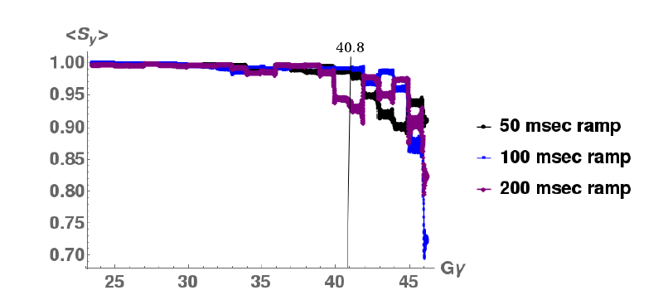
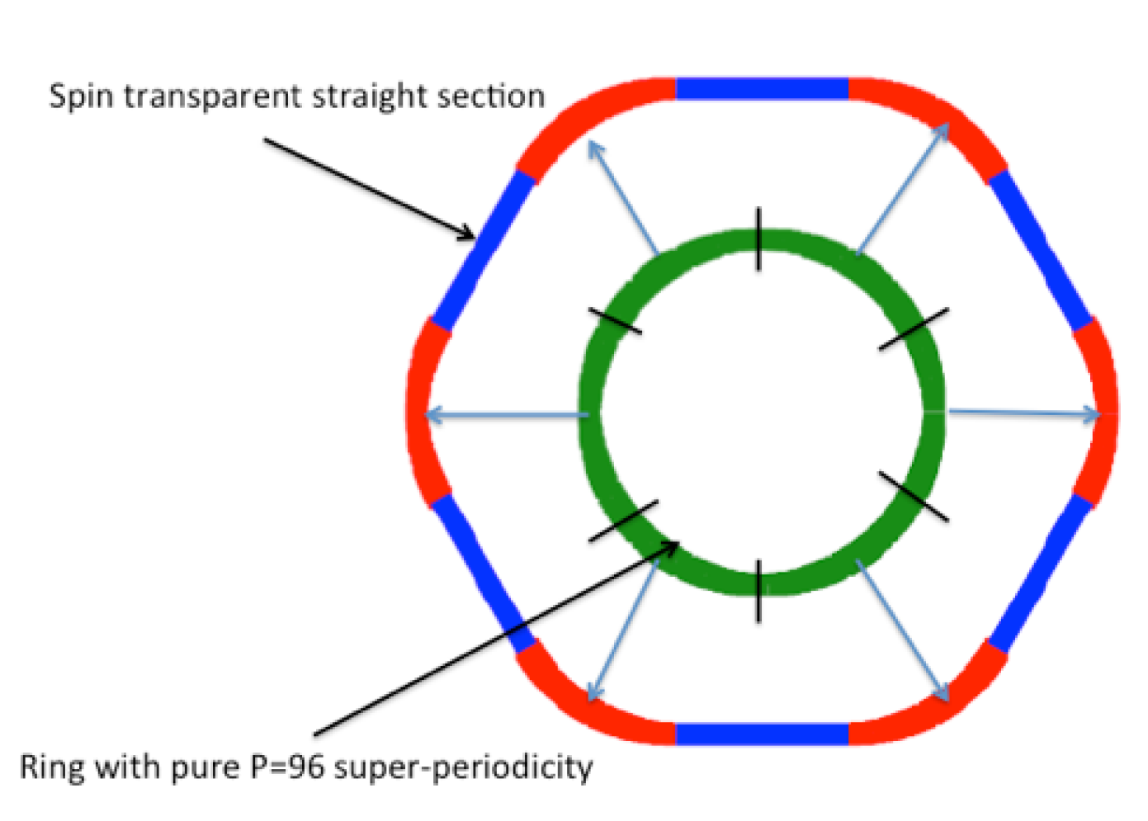
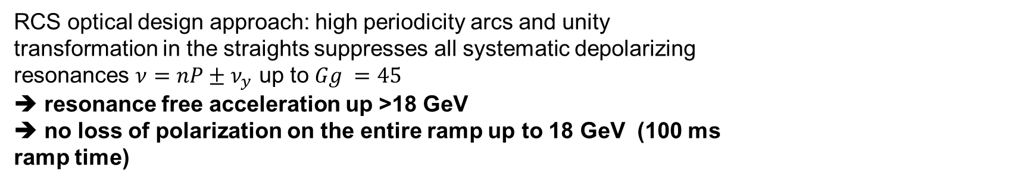
Polarized $e^{−}$: eRHIC Rapid Cycling Synchrotron & CEBAF full-E injector
RCS optical design approach: high periodicity arcs and unity transformation in the straights suppresses all systematic depolarizing resonances $ν=nP±ν_{y}$ up to $Gg =45$
➔ resonance free acceleration up >18 GeV ➔ no loss of polarization on the entire ramp up to 18 GeV (100 ms ramp time)
Up to 12 GeV
to JLEIC
  Use CEBAF as full energy injector with ~90% polarization for
  e-beam top-off
JLEIC will fully benefit from present CEBAF polarization (no upgrades needed)
Need well aligned quadrupoles and rms orbit ≤ 0.5 mm and good reproducibility
➔ Well within the present state of the art of orbit control and achieved today by NSLS-II Booster synchrotron

Slide 19
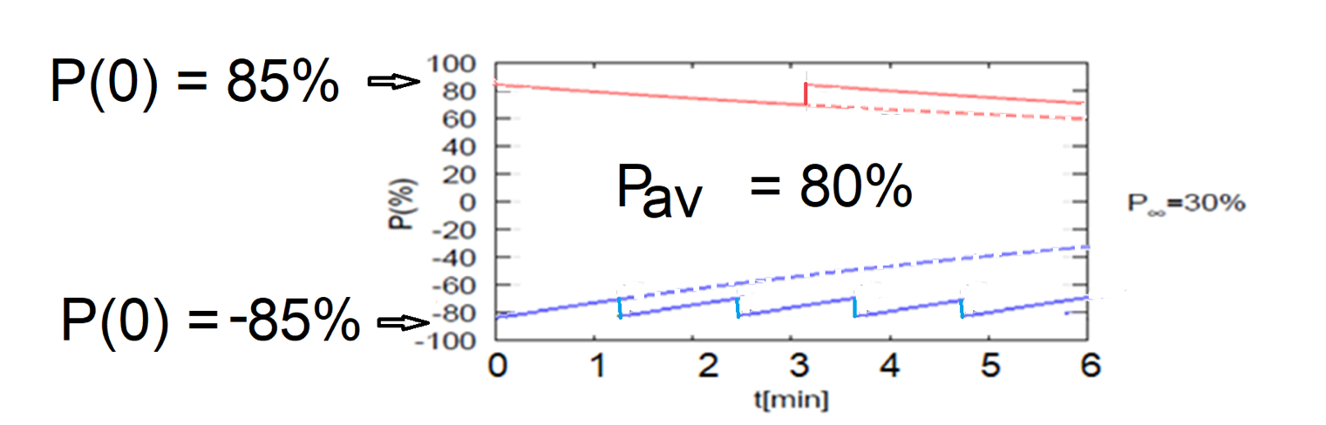
Polarization in the eRHIC electron storage ring
Solenoid based Spin rotators ➔ longitudinal spin in collisions (arcs: vertical polarization)
Frequent injection of bunches with high initial polarization of 85%
Initial polarization decays towards P∞ < ~50%
At 18 GeV, every bunch is refreshed in 2.2 min with RCS cycling rate of 2Hz.
B P
B P
Refilled every 1.2 minutes
(18 GeV electron beam)
Refilled every 3.2 minutes
(18 GeV electron beam)
Re-injection
P∞= 30%
(conservative)
Re-injections

Slide 20
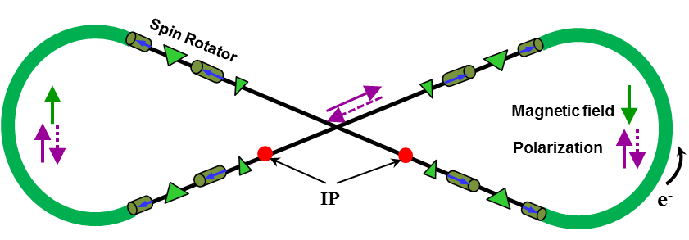
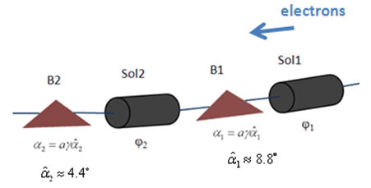


Polarization in the JLEIC electron storage ring
Two highly polarized bunch trains maintained by top-off
Universal spin rotator
  Minimizes spin diffusion
  by switching polarization
  between vertical in arcs
  and longitudinal in straights
  Sequence of solenoid and
  dipole sections
  Geometry independent of energy
  Two polarization states with equal
  lifetimes
  Basic spin match
Advantage of figure-8 geometry:
suppression of non-linear resonances
demonstrated by spin tracking
Arc
IP
$$\vec{s}$$
$$\vec{s}$$

Slide 21
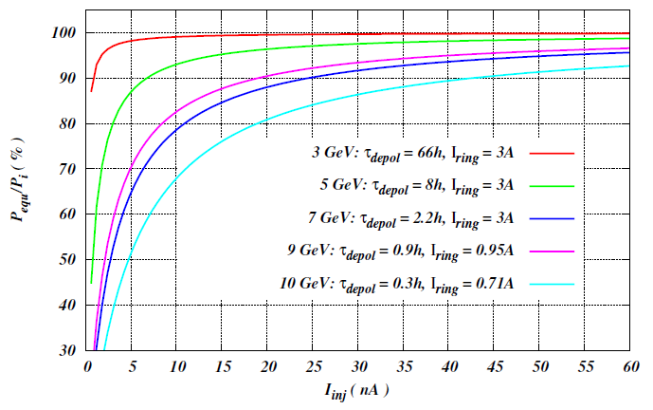
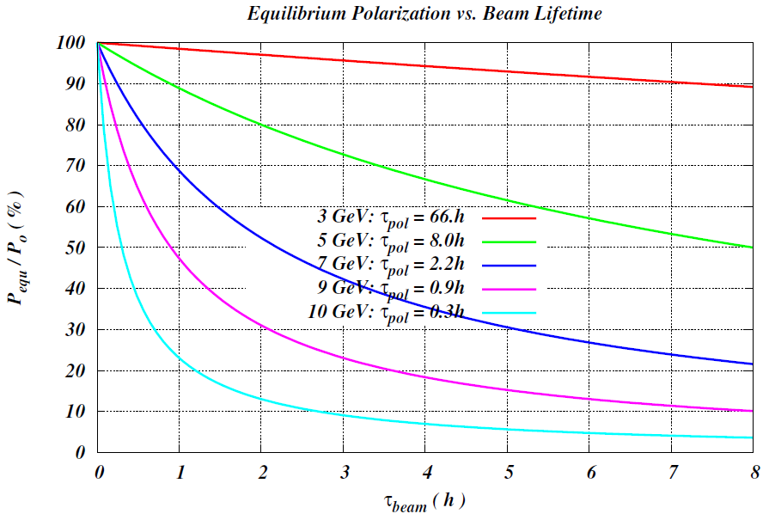

Polarization Lifetime and Continuous Injection in JLEIC
Estimated polarization lifetime
Constant polarization maintained by continuous injection from CEBAF
Equilibrium polarization $P_{equ}=P_{0}{\left(1+\frac{T_{rev}I_{ring}}{τ_{DK}I_{inj}}\right)}^{−1}$
Tens-of-nA level average injected current sufficient to maintain high equilibrium polarization
Beam lifetime must match the beam injection rate and $τ_{beam}≪τ_{pol}$
Energy (GeV) | 3 | 5 | 7 | 9 | 12
Lifetime (hours) | 116 | 9 | 1.7 | 0.5 | 0.1

Slide 22
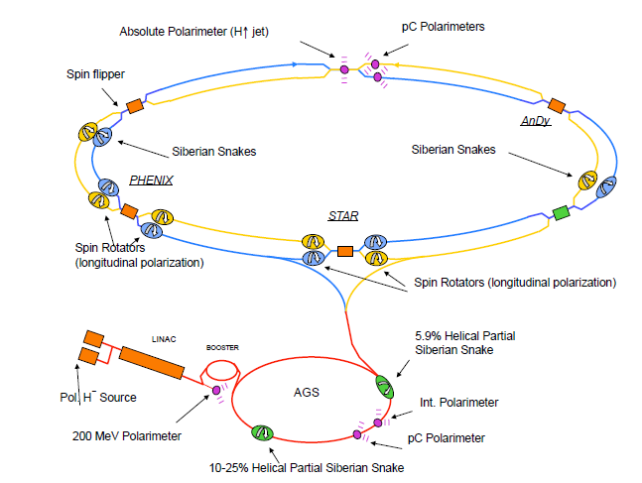
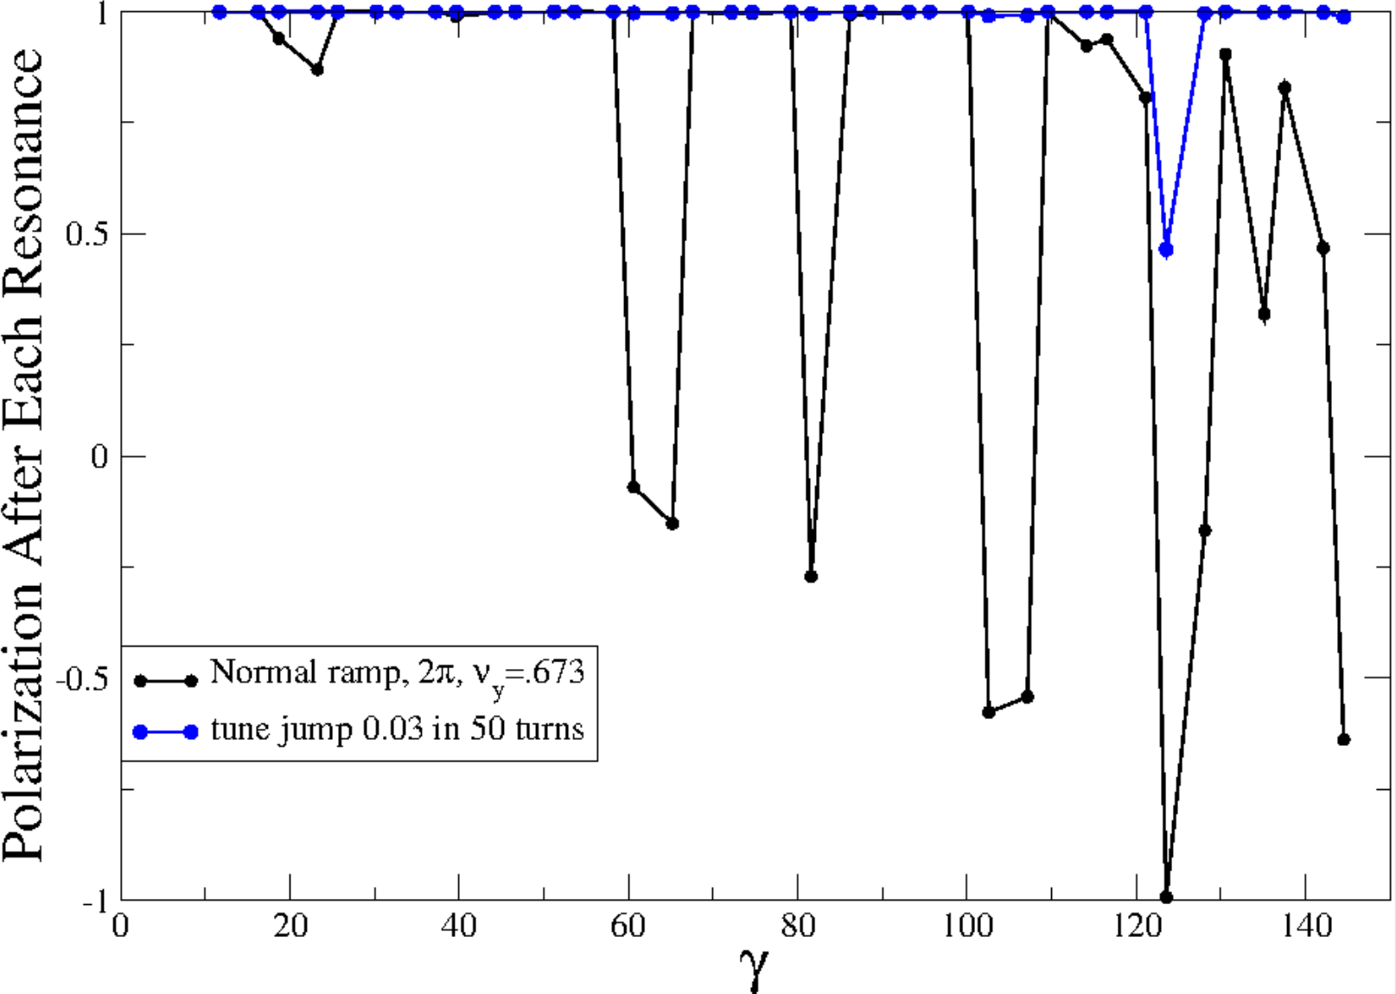
Ion Polarization in eRHIC
Measured RHIC Results:
Proton Source Polarization 83 %
Polarization at extraction from AGS 70%
Polarization at RHIC collision energy 60%
Planned near term improvements:
AGS: Stronger snake, skew quadrupoles,
increased injection energy
➔expect 80% at extraction of AGS
RHIC: Add 2 snakes to 4 existing no polarization loss
expect 80% in Polarization in RHIC and eRHIC
Expected results obtained from simulations which are benchmarked by RHIC operations
³He in eRHIC with six snakes
Achieved 85% polarization in 3He ion source
Polarization preserved with 6 snakes for up to twice the design emittance
Deuterons in eRHIC:
Requires tune jumps in the AGS, then
benchmarked simulation show 100% Spin transparency
No polarization loss expected in the eRHIC hadron ring
eRHIC will fully benefit from present RHIC polarization and near future upgrades

Slide 23
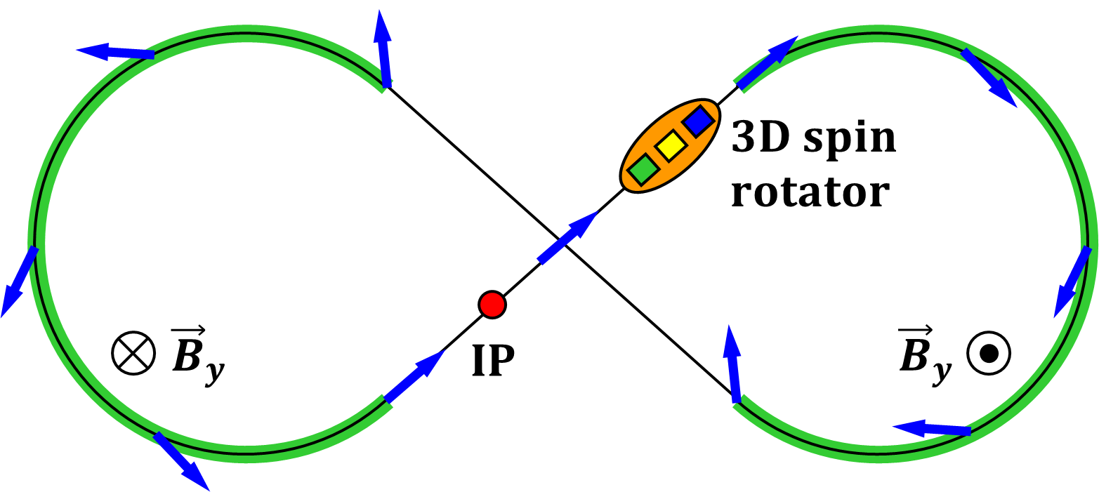
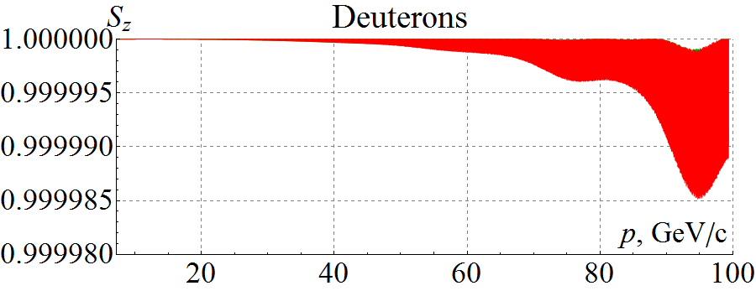
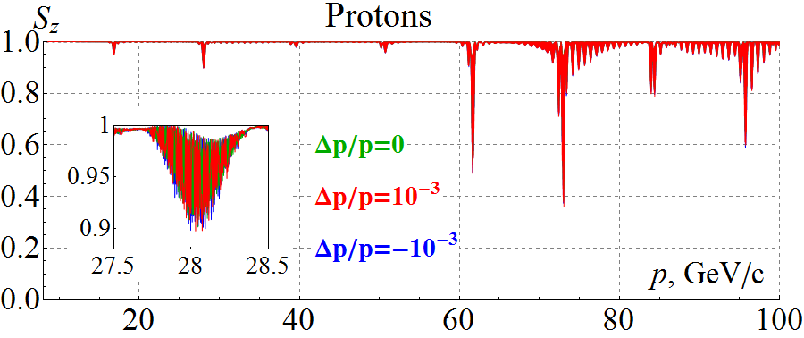
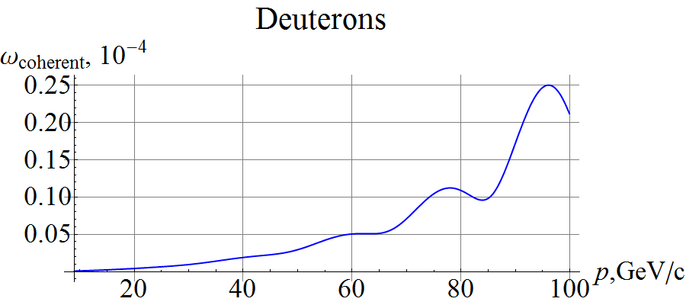
Figure 8 Design Ensures High Ion Polarization
Zero net spin rotation makes spin motion energy independent
Additional fields remove dynamic degeneracy
  Avoid all spin resonances
  Induced spin rotation >> error effect
  Only weak magnetic fields necessary
  Enables 85% polarization
Easily set any polarization at the IP
No orbit perturbation
Polarized deuterons (~3 Tm vs. < 400 Tm at 100 GeV)
100% efficient spin flipping
Experimental verification planned
(Zgoubi simulation)
3 T/min ramp rate
100 µm rms orbit excursion
Analytic prediction
100 µm rms orbit excursion
Polarization tilts without loss

Slide 24
Interaction Region Design
The interaction regions are the most challenging parts of an EIC design
The EIC physics requires nearly 100% acceptance, including stringent requirements on the detection of final state particles in the directions along the beamline
  Both designs use a crossing angle, compensated by crab cavities, and arrange the magnet apertures and locations of detectors to allow large forward coverage
IRs need to fit several essential components into a relatively small area
  Strong focusing, auxiliary detectors, masks and collimators, diagnostics
  The accelerator components should not compromise the detector acceptance
Design has to take into account that there are beam dynamics constraints:
  IR chromaticity and related dynamic aperture issues, beam-beam tune shift, tight tolerances for magnet errors, residual crab cavity effects, …

Slide 25





Interaction Region Concept
Possible to get ~100% acceptance for the whole event
EIC detector must accept and measure all particles from the interaction. (Unlike existing collider detectors!)
Central Detector/Solenoid
Ion beamline
Scattered Electron
Electron beamline
Dipole
Dipole
Forward (Ion) Detector
Particles Associated
with struck parton
Particles Associated
with Initial Ion

Slide 26
EIC parameters in detail & Interaction Region
EIC parameters for selected E of cases shown in the Lumi plot. L_{ave} numbers with * are without strong cooling.

Slide 27
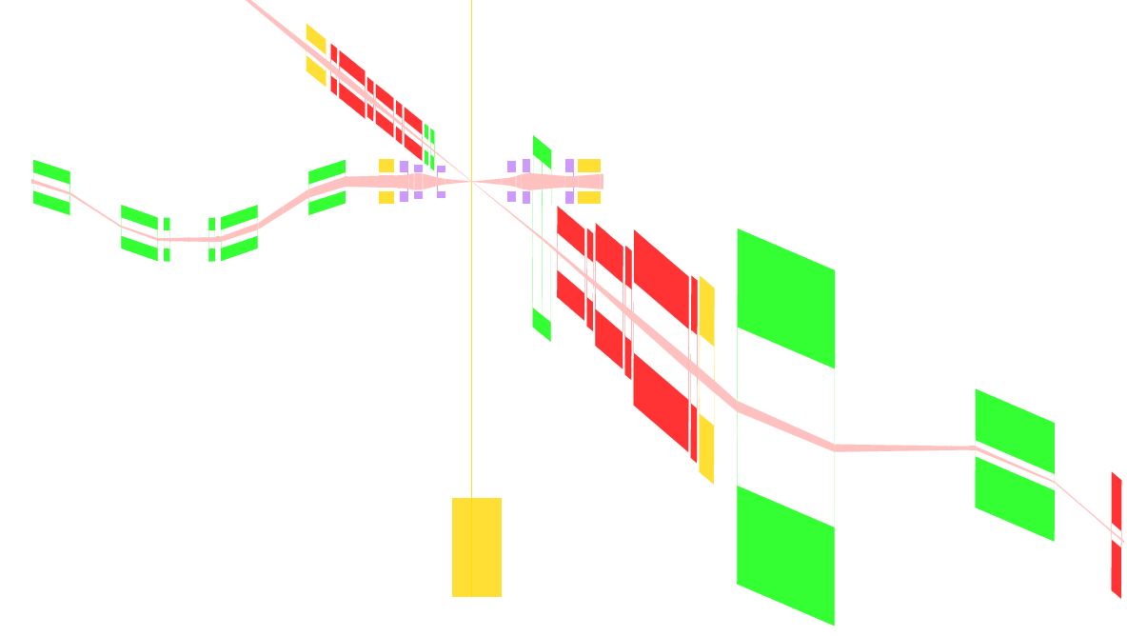




Full Acceptance JLEIC IR Layout
10.5 m central detector space
50 mrad crossing angle
Forward hadron detection in three stages
  Endcap
  Small dipole covering angles up to ~3°
  Far forward, ~10 mrad,
  for particles passing through
  accelerator quads
Low-$q^{2}$ tagger
  Small-angle electron detection
Large beta functions in the IR up to 4 km but
manageable chromatics and dynamic aperture
Only NbTi magnet technology needed
End caps
Roman pots
hadrons
electrons
$±50$ mrad
Secondary
focus
Low $Q^{2}$ tagger
Central detector
$±10$ mrad

Slide 28
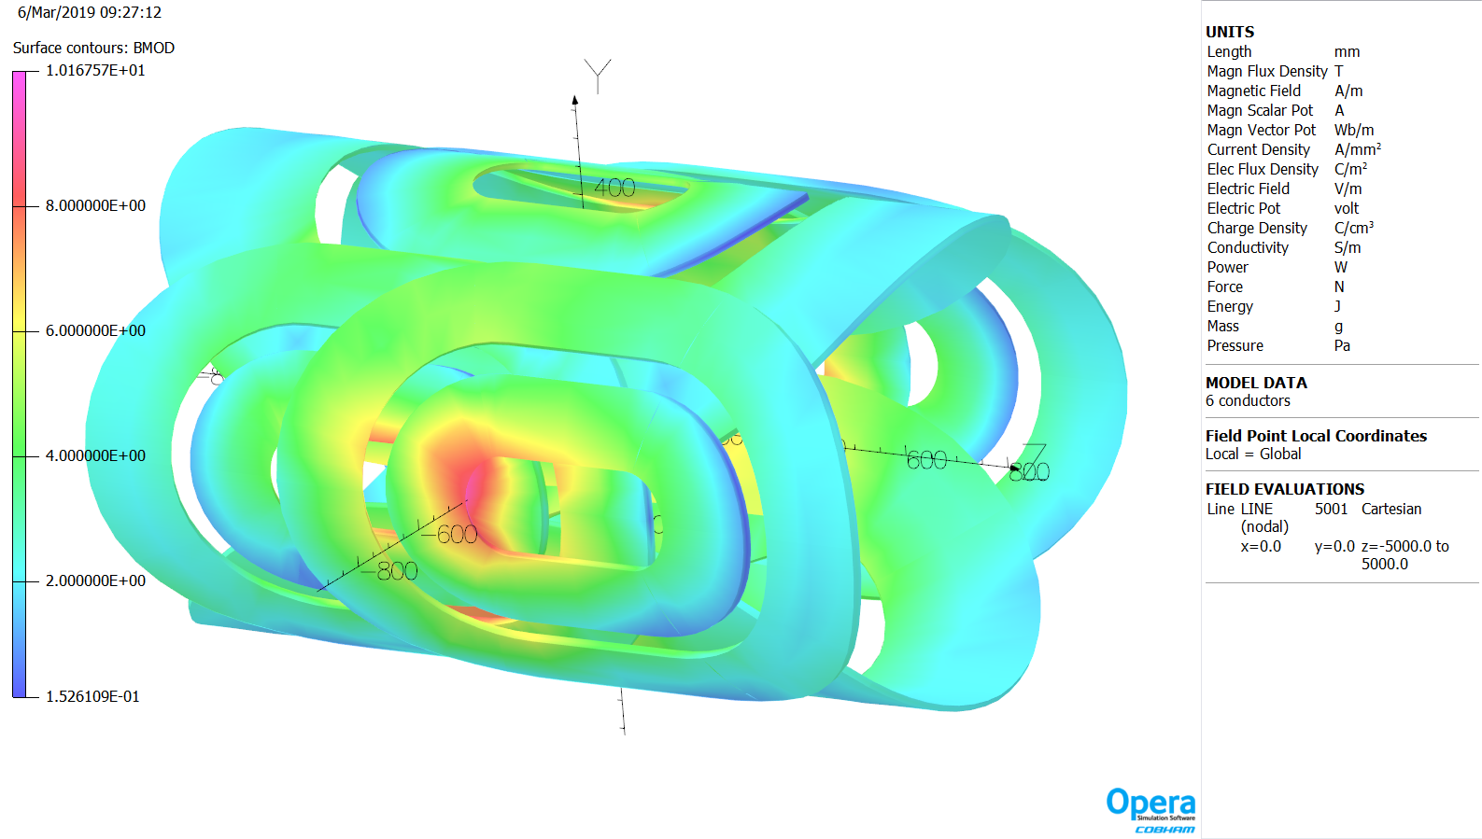
JLEIC First Ion Spectrometer Dipole
By: 1.32 T x 1.5 m
Bx: 0.22 T x 0.75 m
and
–0.19 T x 0.75 m

Slide 29
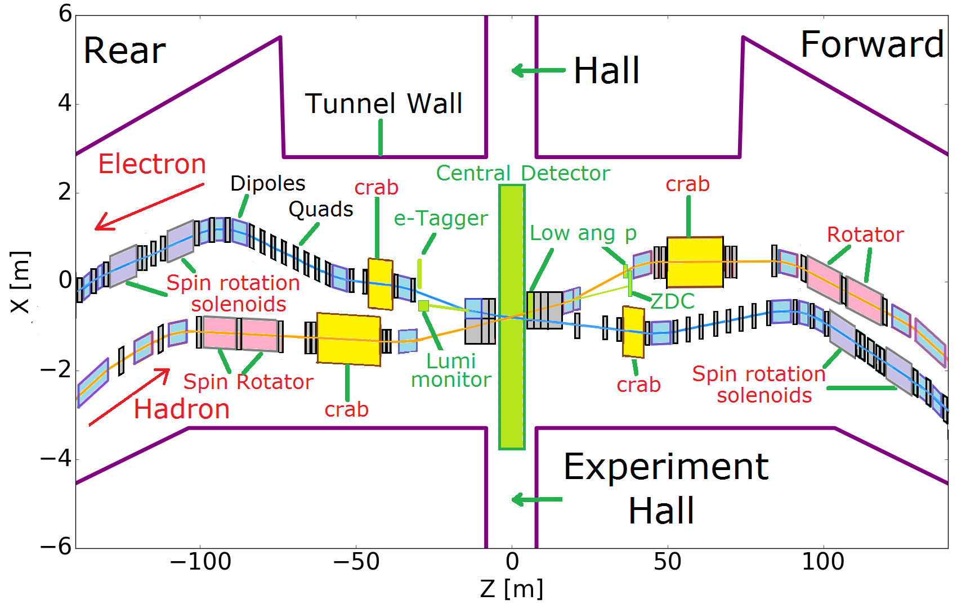
Full Acceptance eRHIC IR Layout
Design
All superconducting magnets
Only 5 magnets need collared Nb-Ti coils
All other magnets can be built with direct wind of Nb-Ti wire
Full acceptance e.g.
P_{t} =200 MeV/c-1.3 GeV/c
Neutrons 4 mrad
Large Aperture Dipole with instrumented gap
Modest IR chromaticity
Hadrons up to β<200m
Manageable dynamic
aperture optimization
e-Tagger
LUMI Mon.

Slide 30
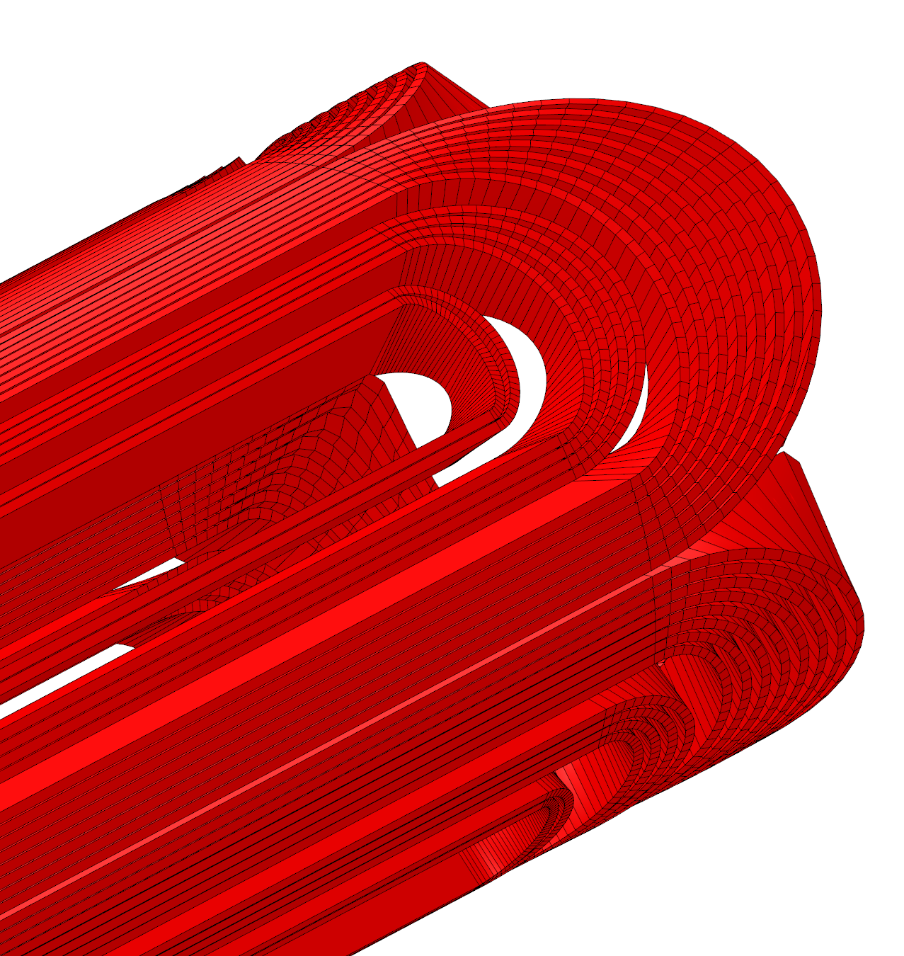
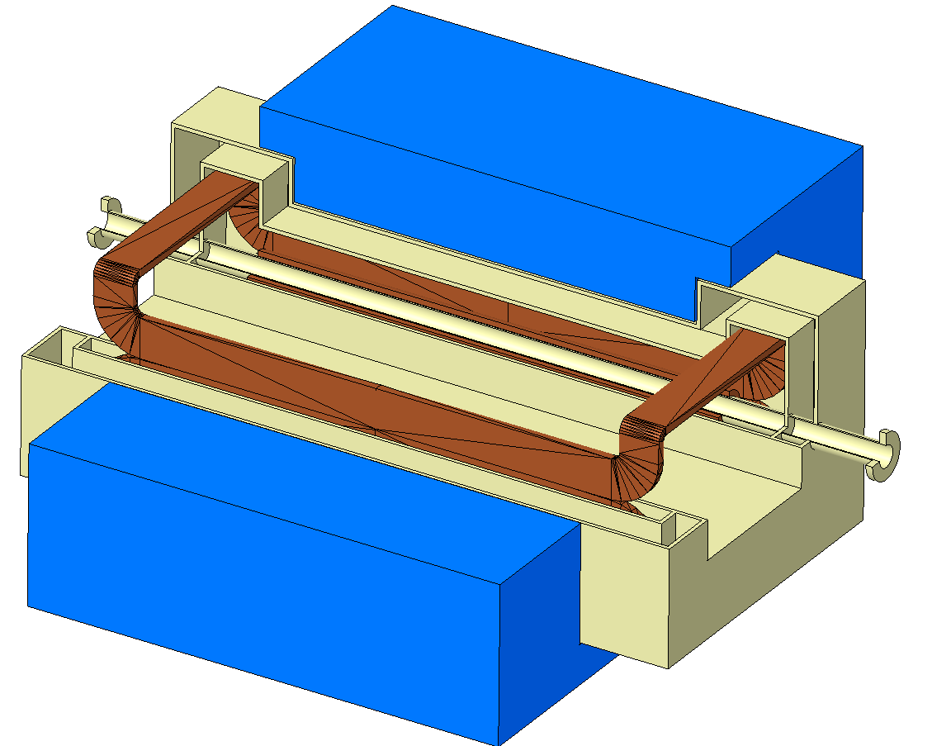
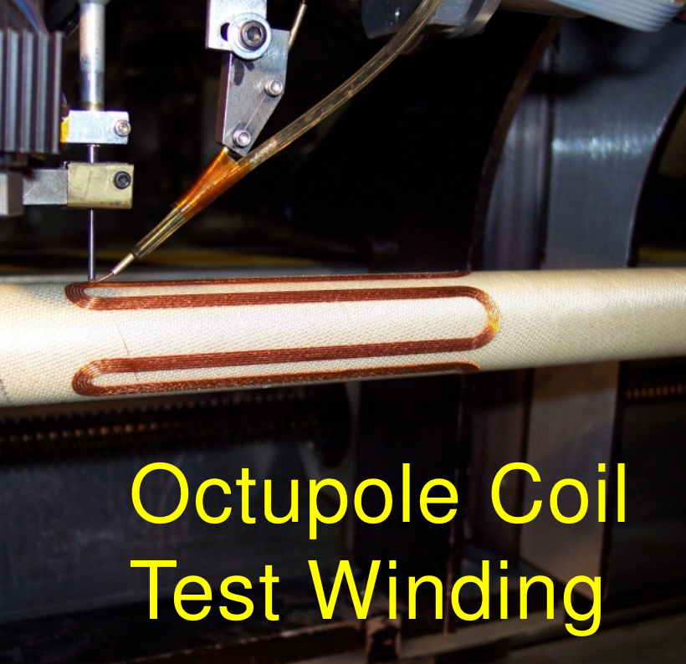
eRHIC IR Magnets
Three types of superconducting magnets
  All NbTi
9 Direct Wind Magnets
(S-MD)
6 Collared Magnets
1 Special Magnet

Slide 31
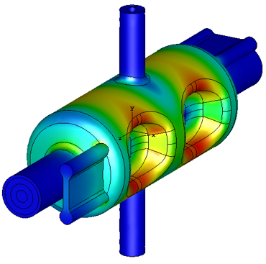
On-Going EIC R&D Effort
Component Development
Crab Cavity design development and prototyping
IR magnet development and prototyping
HOM damping for RF structure development
Variable coupling high power forward power couplers development
Effective in situ Cu coating of the beam pipe (BNL hadron only)
High average current electron gun development
Polarized ³He source
Bunch by bunch polarimetry
Accelerator Physics R&D
Strong hadron cooling CeC, cooling development (simulation and experimental)
Strong hadron cooling bunches electron beam cooling (simulation and experimental)
ERL development for strong hadron cooling
Test of suppression of intrinsic depolarizing resonances
Experimental verification of figure-8 spin transparency
Study of residual crab cavity effect on beam emittance
Instrumented accelerator magnet
Crab cavity prototypes developed for CERN SpS tests
Crabbed beam dynamics

Slide 32
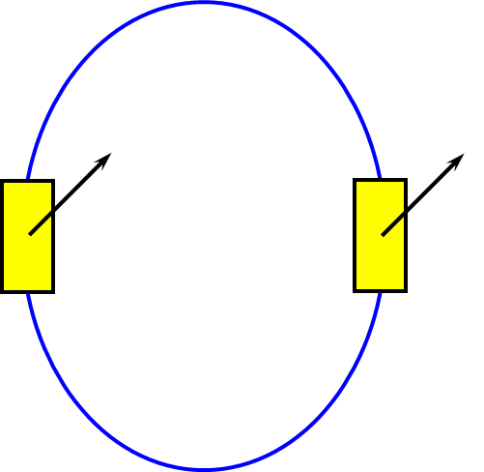
Joint BNL & JLab Transparent Spin Experiment
A number of novel polarization preservation and control techniques have been developed for JLEIC
  Transparent spin mode
    Figure-8 ring
    Racetrack with two identical Siberian snakes separated by 180° bend
  3D spin rotator: small rations about three orthogonal axes = rotation about any direction
  Polarized deuteron beam at higher than ever before energies
  New spin dynamics theory and analytic and simulation tools
Spin transparency mode is of interest to BNL for the eRHIC electron collider ring
Plan experimental verification of theory and simulations at single energy
=

Slide 33
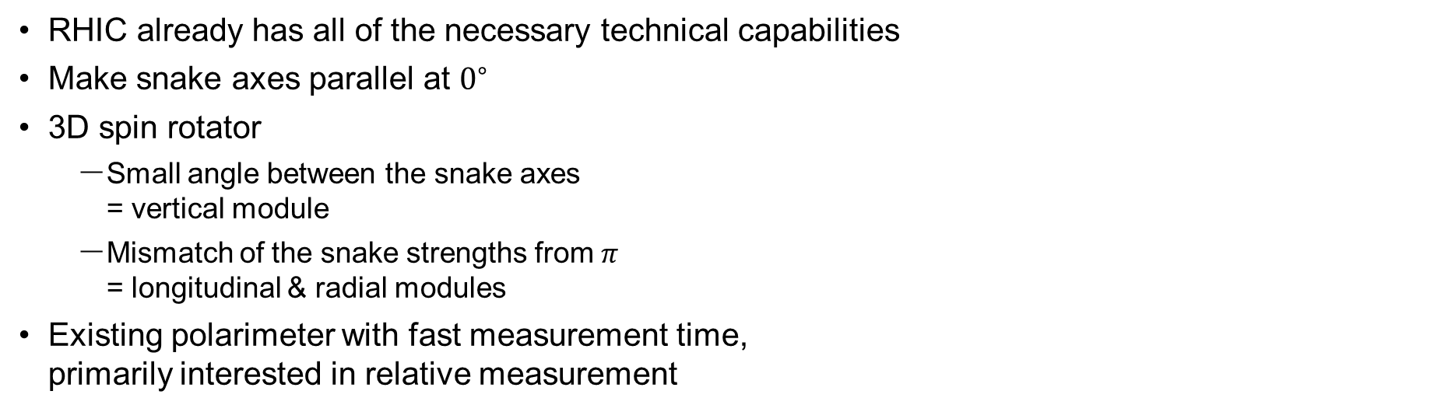
RHIC in Transparent Spin Mode
RHIC already has all of the necessary technical capabilities
Make snake axes parallel at $0^{∘}$
3D spin rotator
  Small angle between the snake axes
  = vertical module
  Mismatch of the snake strengths from $π$
  = longitudinal & radial modules
Existing polarimeter with fast measurement time,
primarily interested in relative measurement

Slide 34
https://indico.fnal.gov/event/21416/

Slide 35
EIC will boost accelerator technology impact on other areas
NAS report: “development of an EIC would advance accelerator science and technology in
nuclear science; it would also benefit other fields of accelerator-based science and society, from medicine through materials science to elementary particle physics.”
New beam control technologies
High field magnets
Fast kickers
Detector magnets
Chart from Robert W. Hamm, Accelerator Industrial Stewardship event, JLAB, December, 2018

Slide 36
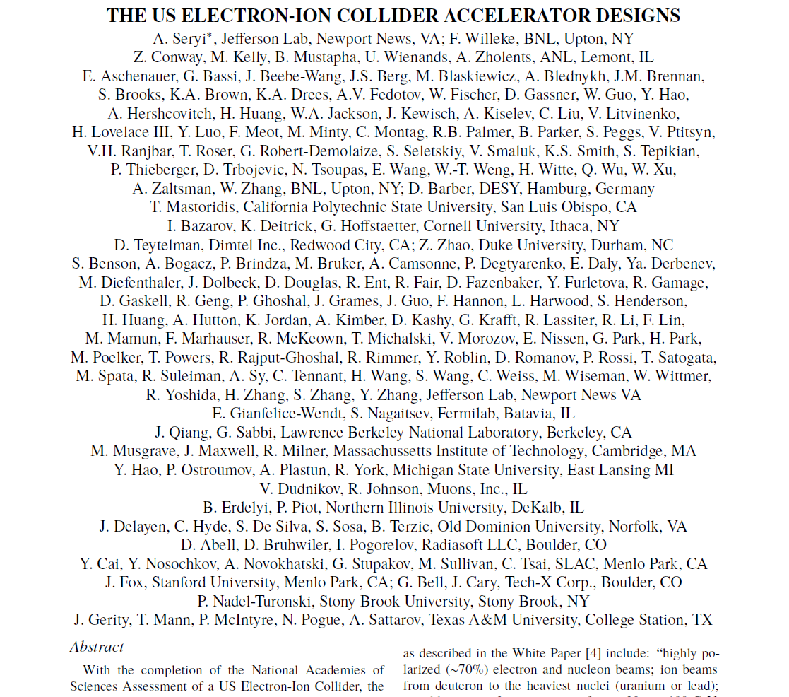
Summary
https://napac2019.vrws.de/papers/moohc2.pdf
The future EIC will be much more capable and much more challenging to build than earlier electron or polarized proton machines
It will be the most sophisticated and challenging accelerator currently proposed for construction in the United States and will significantly advance accelerator science and technology in the US and around the world
The EIC design team is working on optimization and analyzing the performance of both design concepts and is looking forward for collaborative efforts for making the EIC a reality

