Slide 1
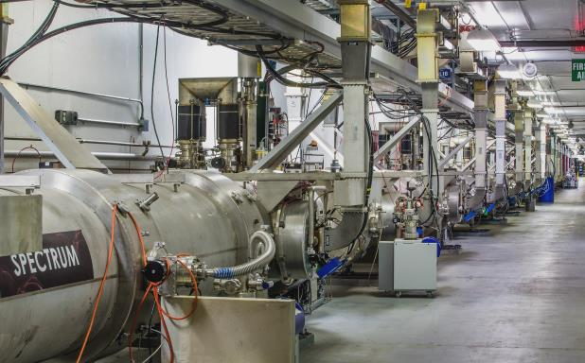
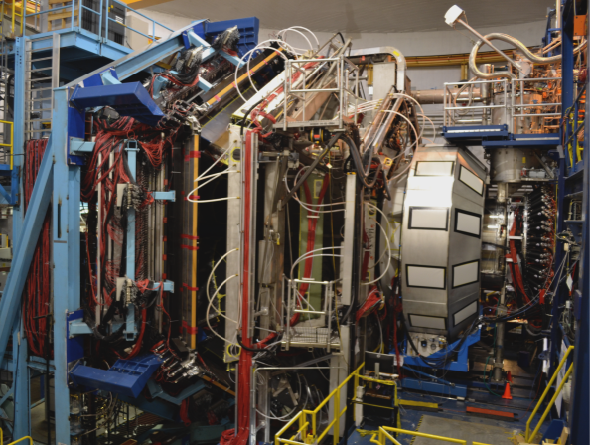
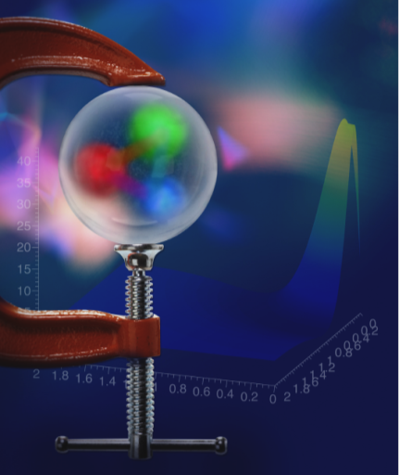
The Gravitational Structure of the Proton
Proton Pressure Distribution
First Extraction
Latifa Elouadrhiri
Jefferson Lab
13th European Research Conference on Electromagnetic Interactions with Nucleons and Nuclei
27 October – 02 November 2019
Paphos, Cyprus

Slide 2

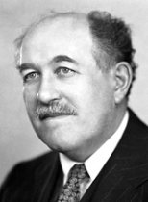
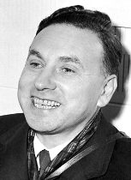
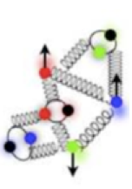
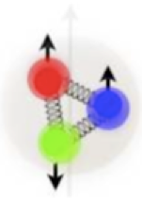
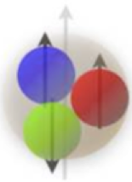
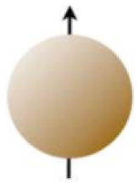
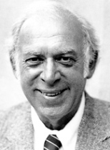
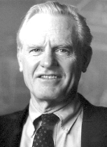

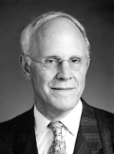


What is inside the proton/neutron?
1933: Proton’s magnetic moment
1960: Elastic e-p scattering
Nobel Prize
In Physics 1943
Nobel Prize
In Physics 1961
Otto Stern
Robert Hofstadter
"for … and for his discovery of the magnetic moment of the proton".
"for … and for his thereby achieved discoveries concerning the structure of the nucleons"
1969: Deep inelastic e-p scattering
1974: QCD Asymptotic Freedom
Nobel Prize in Physics 1990
Nobel Prize in Physics 2004
Jerome I. Friedman,
Henry W. Kendall,
Richard E. Taylor
David J. Gross,
H. David Politzer,
Frank Wilczek
"for their pioneering investigations concerning deep inelastic scattering of electrons on protons …".
"for the discovery of asymptotic freedom in the theory of the strong interaction".

Slide 3
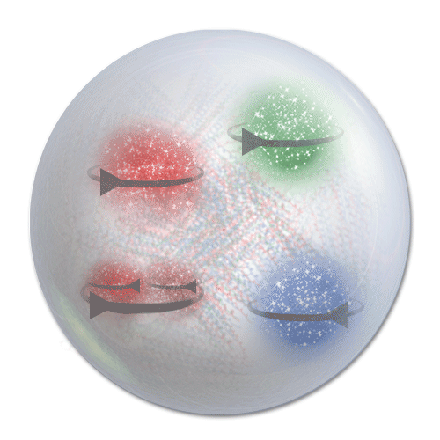
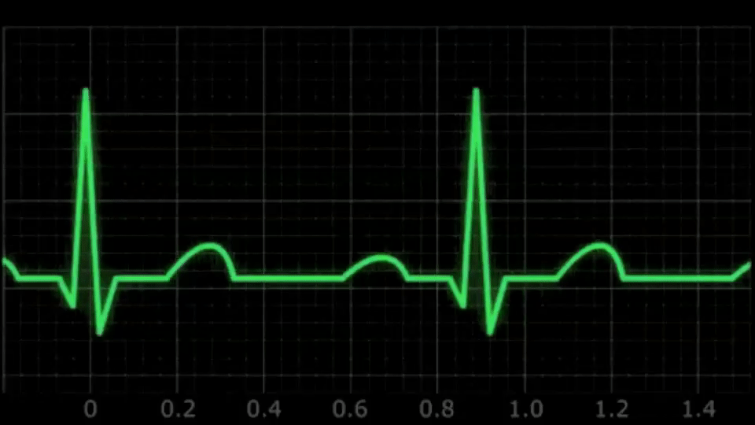
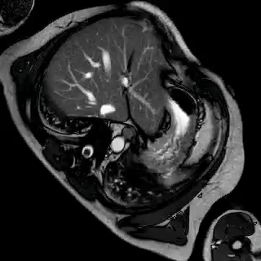
QCD Science Questions
How are the quarks and gluons, and their intrinsic spins distributed in space & momentum inside the nucleon?
What is the role of orbital motion?
      What are Pressure & Forces distributions??
      Color confinement & its origin?

Slide 4



Generalized Parton Distributions
Last 60 years
Last 45 years
Last 20 years
Elastic form factors → Transverse charge & current
densities F₁(t), F₂(t).
DIS structure functions
→ Longitudinal parton
momentum & helicity
densities, F₂(x), g₁(x).
Deeply exclusive processes → GPD’s and 3 D images in transverse space and longitudinal momentum.
4 GPDs H, E, H, E (x,ξ,t)
~
~
4

Slide 5

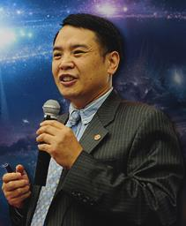

GPDs and QCD
The Generalized Parton Distributions (GPDs) provide the theoretical framework to interpret the experimental data
Breakthrough in theory of QCD (1990s): developing Deeply Virtual Compton Scattering (DVCS) as a tool to characterize the structure of the nucleon within QCD and showing how its properties can be probed through experiments.
D. Mueller (1994), X.Ji (1996), A.Radyushkin (1996)

Slide 6
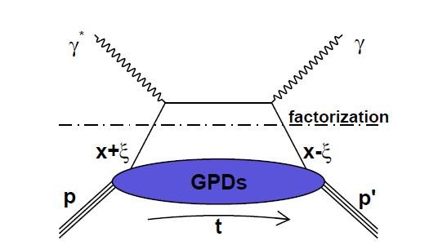
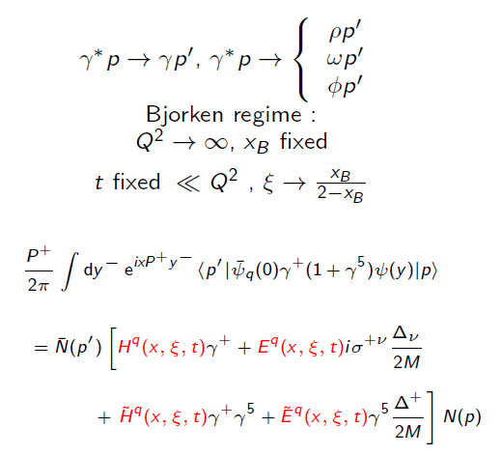
Deeply Virtual Compton Scattering (DVCS) and GPDs
DVCS and Generalized Parton Distributions
x: average fraction of quark
longitudinal momentum
:fraction of longitudinal
momentum transfer
~
~
H, E, H, E : Generalized Parton Distributions (GPDs)
3-D Imaging conjointly in transverse impact parameter and longitudinal momentum

Slide 7
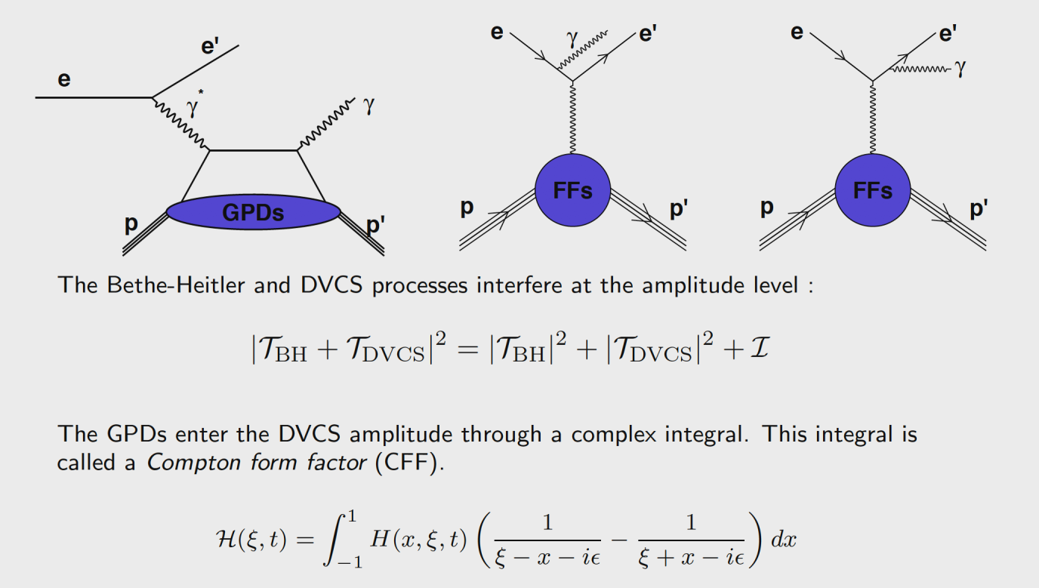
Deeply Virtual Compton Scattering - Experiment
Measured both asymmetries and cross sections

Slide 8
Facilities & Equipment to Explore Hadron Structure
Facilities and equipment to Explore Hadron Structure became possible with all the advancement in detector, Electronics and Computing technologies
Unprecedented capabilities:
  High Intensity
  High Duty Factor
  High Polarization
  Large acceptance detectors
  State-of-the-art polarimetry and polarized targets
  High luminosity
  …
Facilities and laboratories working together

Slide 9
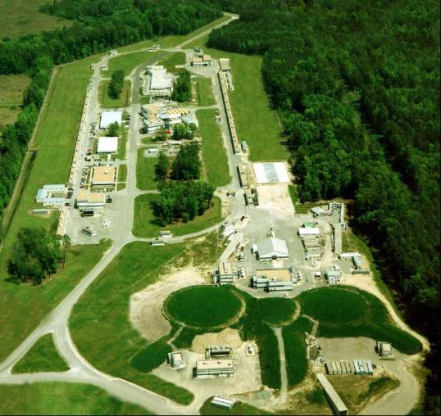
Jefferson Lab Overview
One of 17 U.S. Department of Energy National Laboratories Single program focus on Nuclear Physics Created to build and operate the Continuous Electron Beam Accelerator Facility (CEBAF), world-unique user facility for Nuclear Physics Mission is to gain a deeper understanding of the structure of matter Through advances in fundamental research in nuclear physics Through advances in accelerator science and technology In operation since 1995 Managed for DOE by Jefferson Science Associates, LLC (JSA)
Jefferson Lab by the numbers: 700 employees 169 acre site 1,600 Active Users 27 Joint faculty 608 PhDs granted to-date (more than 200 in progress) K-12 programs serve more than 12,000 students and 950 teachers annually

Slide 10
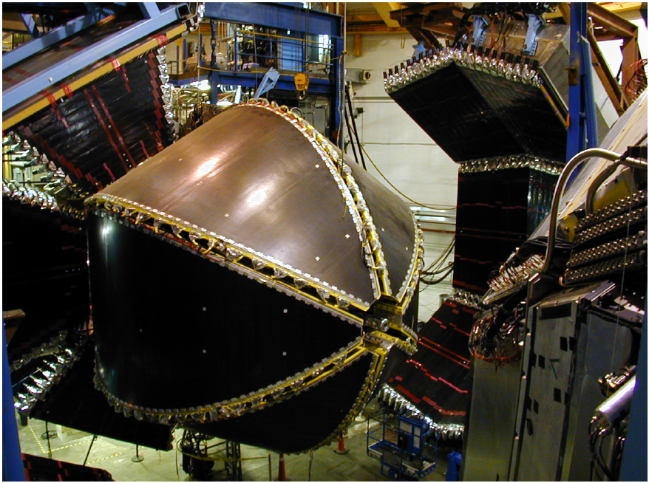
CLAS Experiment
In operation 1997 – 2012

Slide 11
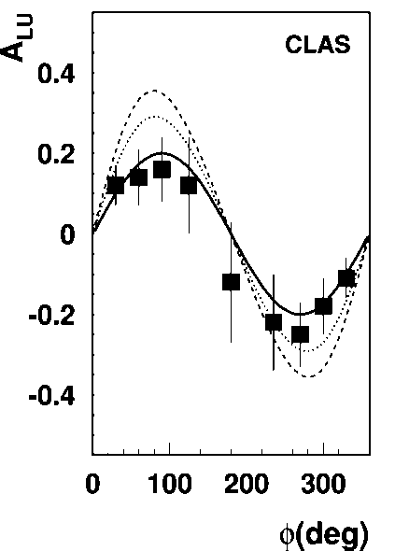
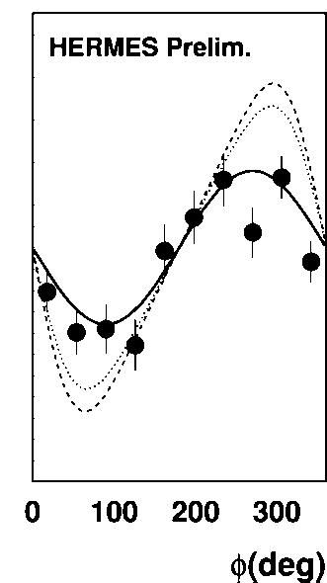
Pioneering experiments observe interference !
JLab
2001
HERA
e⁻p−>e⁻pγ
e⁺p−>e⁺pγ
A_{UL} = αsinφ + βsin2φ
First GPD analyses of HERA/CLAS/HERMES
data in LO/NLO consistent with a ~ 0.20
twist-2
twist-3

Slide 12
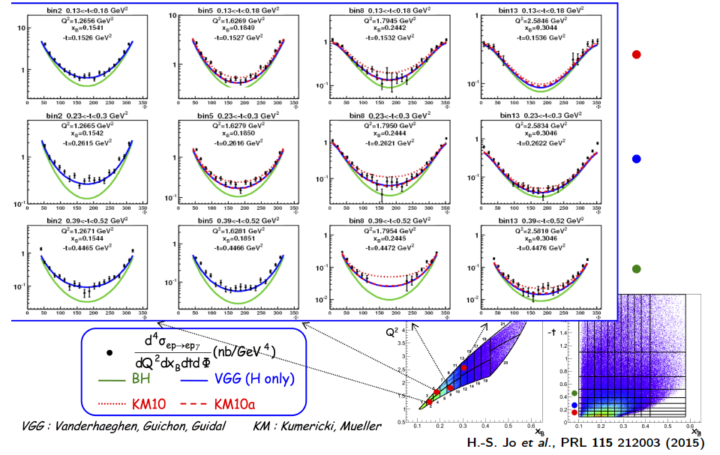
DVCS Unpolarized Cross-Sections

Slide 13
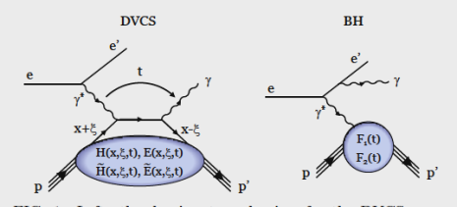
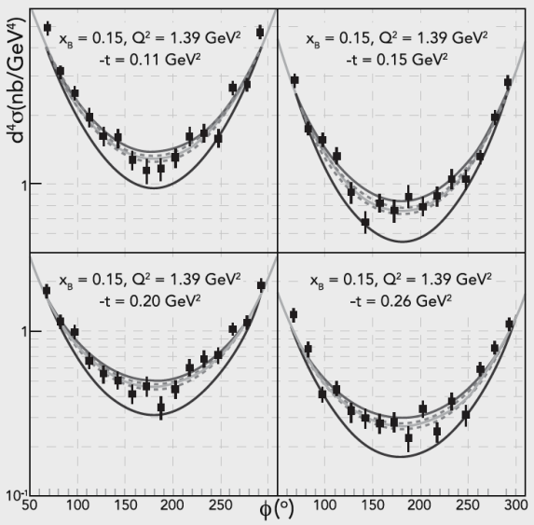
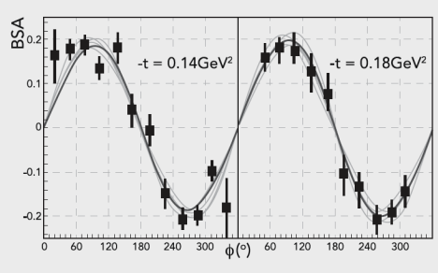
Fits to determine H(ξ ,t)
Samples of differential cross sections with fits
Samples of Beam Spin Asymmetry with fits
DVCS - BSA
F.X. Girod et al., Phys.Rev.Lett. 100 (2008) 162002 H.S. Jo et al., Phys.Rev.Lett. 115 (2015) 212003
Notes:
This graph shows examples of the global fit, the solid grays line, and of the local fits (the thin lines) to the data.

Slide 14
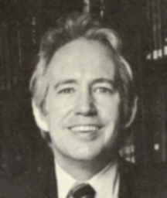
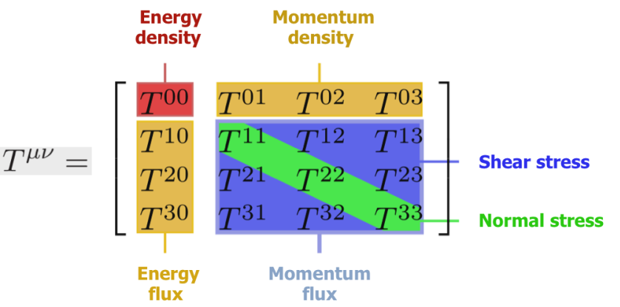

Probing Gravitational properties of the proton?
Energy-Momentum Structure Form Factors of Particles Heinz Pagels, Phys. Rev. 144 (1966) 1250-1260
Heinz Pagels
(1939-1988)
s(r) – distribution of forces (stress)
p(r) – distribution of pressure
“Contrary to the case of electromagnetism, there is very little hope of learning anything about the detailed mechanical structure of a particle, because of the extreme weakness of the gravitational interaction”

Slide 15
Why study mechanical properties of particles?
The mechanical size of the proton is a fundamental quantity and has never been measured
The studies open up an experimentally unexplored avenue of fundamental research in nuclear physics
They relate to macroscopic objects in the universe such as neutron stars whose properties are governed by gravity

Slide 16
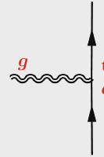
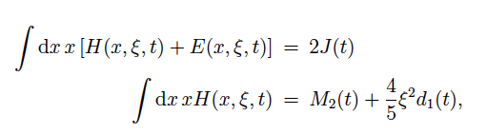
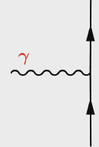
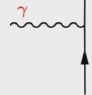
The GPDs and Gravitational Form factors
Nucleon matrix element of the Energy-Momentum Tensor contains three scalar form factors (R. Pagels, 1966) and can be written as (X. Ji, 1997):
M₂(t) : Mass distribution inside the nucleon
J (t) : Angular momentum distribution
d₁(t) : Forces and pressure distribution
Graviton scattering
p
Gp => p
GPDs
GFFs
G
p
DVCS
p
γ
γγp => p
γ
p
X. Ji, Phys. Rev. Lett. 78, 610 (1997)
X. Ji, Phys. Rev. D55, 7114 (1997)

Slide 17
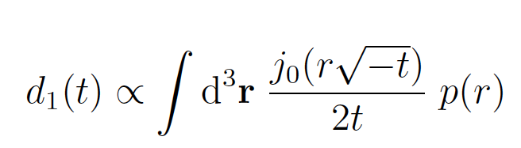
From GFF to mechanical properties
Relation of d₁(t) to the pressure distribution given through
Bessel integral:
M. Polyakov, Phys.Lett. B555 (2003) 57

Slide 18


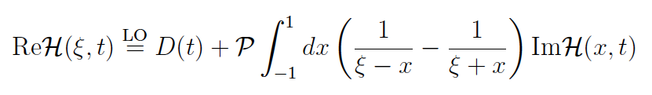
From GPDs to Compton Form Factors (CFF)
DVCS
BH
Polarized beam:
Δσ_{LU} ~ Im{F₁H(ξ,t)+....}
Unpolarized beam:
dσ_{U} ~ {ReH(ξ,t)+…}
H(ξ,t)
D(t)
~
(With assumptions on CFF E, H)
Notes:
We can define the Compton FF, e.g. H(xi, t) through this integral over the quark momentum fraction x. With this simplification we can proceed and determine the CFF H(xi, t) through a number of steps: 1) The imaginary part of the CFF H can be extracted through the interference of CFF H with BH amplitude leading to Im(H) since BH amplitude is real. 2) the Real part may be extracted from cross section measurements directly, and through a dispersion relation connecting real and imaginary parts of CFF H(xi,t) and the connection with GFF d1(t).

Slide 19
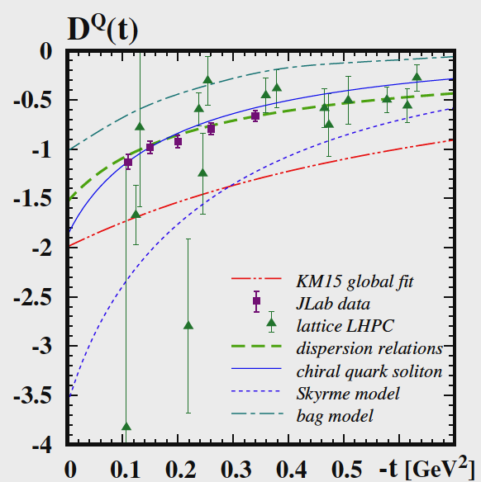
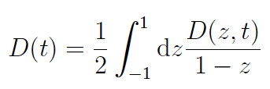
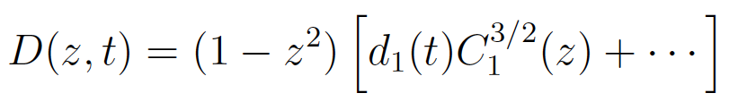
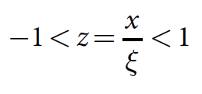
D^{Q}₁(t) - Gravitational Form Factor
Expansion in Gegenbauer polynomials
with
d₁(0) < 0 dynamical stability of bound state
d^{Q}₁(0) = -2.04 ± 0.14 ± 0.33
First determination of new fundamental quantity.

Slide 20
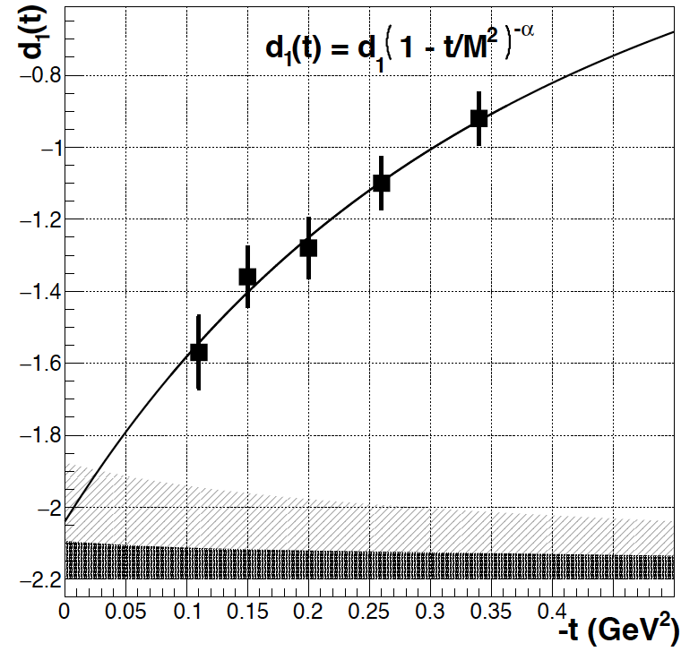
D^{Q}₁(t) - Gravitational Form Factor
Expansion in Gegenbauer polynomials
with
d₁(0) < 0 dynamical stability of bound state
d^{Q}₁(0) = -2.04 ± 0.14 ± 0.33
systematic uncertainties
First determination of new fundamental quantity.

Slide 21
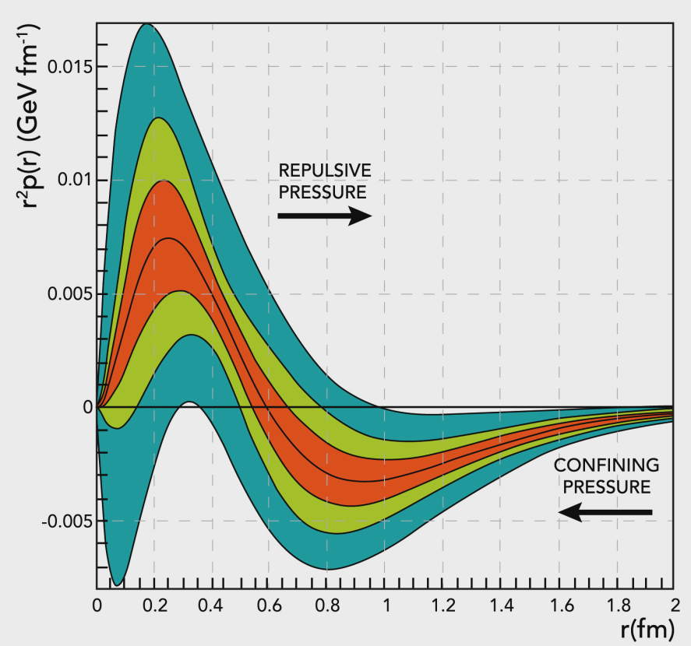




The pressure distribution inside the proton
Repulsive pressure at
r < 0.6 fm <p> 10³⁵ Pa
Confining pressure at
r > 0.6 fm
Nature 557 (2018) no.7705, 396-399
V. Burkert, L. Elouadrhiri, F.X. Girod
This work opens up a new area of research on the fundamental gravitational properties of protons, neutrons and nuclei, which can provide access to their physical radii, the internal shear forces acting on the quarks and their pressure distributions.
Atmospheric pressure: 10⁵ Pa
Pressure in the center of neutron stars < 10³⁴ Pa

Slide 22
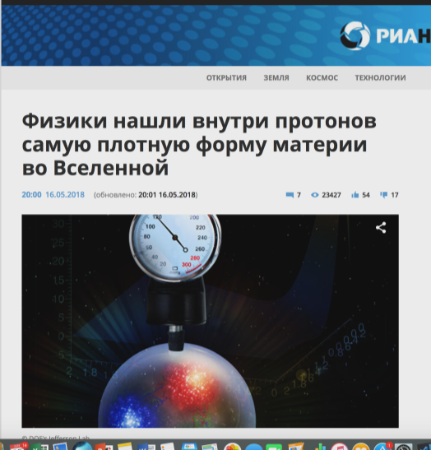
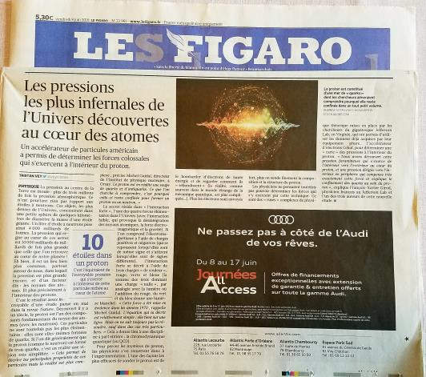
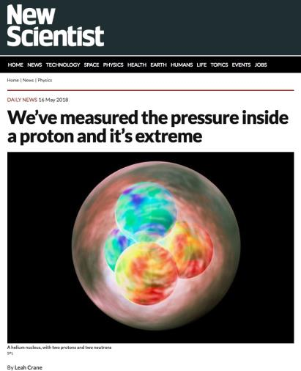
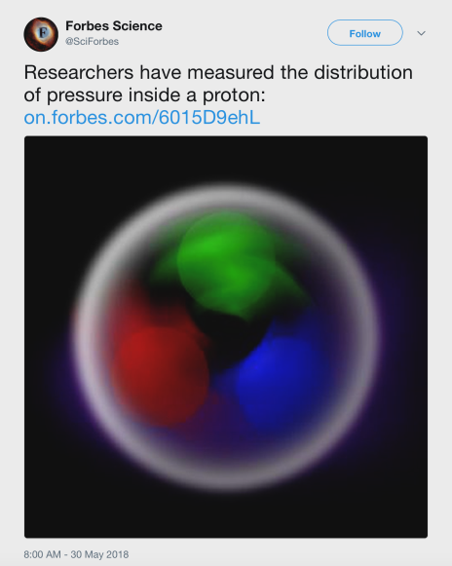
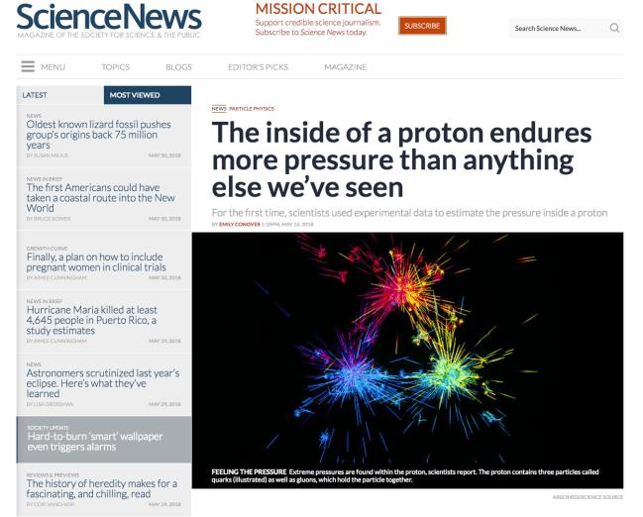


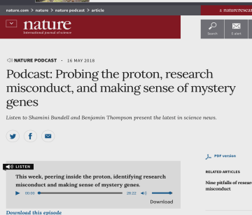
In the News

Slide 23
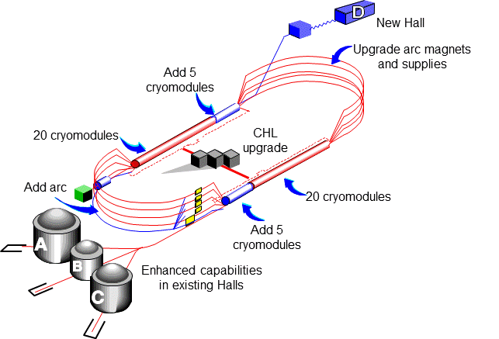
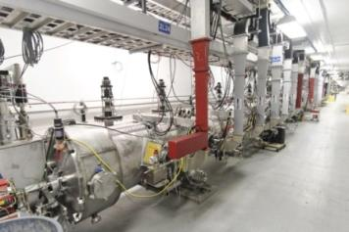
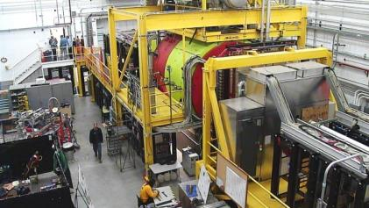


12 GeV CEBAF Upgrade Project is Complete, On-time and On-Budget!
Project Completion Approved September 27, 2017

Slide 24

12 GeV CEBAF Upgrade Project is Complete, On-time and On-Budget!
Secretary of Energy Project Management Achievement Award
Project Completion Approved September 27, 2017

Slide 25


DVCS with polarized e⁻ beam in Hall A/C
E12-06-114

Slide 26

The CLAS12 Detector
Baseline equipments
Forward Detector (FD)
  - TORUS magnet (6 coils)
  HT Cherenkov Counter
  Drift chamber system
  LT Cherenkov Counter
  Forward ToF System
  Pre-shower calorimeter
  E.M. calorimeter
Central Detector (CD)
  SOLENOID magnet
  Barrel Silicon Tracker
  Central Time-of-Flight
Beamline
  Polarized target (transv.)
  Moller polarimeter
  Photon Tagger
Upgrade of the CLAS Detector
Optimized for exclusive and semi-inclusive reactions
Capable to operate at luminosity up to 10³⁵ cm⁻²sec⁻¹
To be used with polarized target
Particle ID up to high momentum for e⁻/π⁻, π/K/p, γ/πº separation
Good momentum & angle resolution for use of missing mass techniques
Coverage of large ranges in ϑ and φ angles
Upgrades to the baseline &
under construction
RICH detector (FD)
  Forward Tagger (FD)
  Neutron detector (CD)
  Micromegas (CD)
  Polarized target (long.)

Slide 27

A path towards extracting GPDs
σ⁺ − σ⁻
σ⁺ + σ⁻
Δσ
2σ
ξ ~ x_{B}/(2-x_{B})
A =
=
k = t/4M²
Polarized beam, unpolarized target:
~
H(ξ,t)
Δσ_{LU} ~ sinφ {F₁H + ξ(F₁+F₂)H +kF₂E}dφ
Unpolarized beam, longitudinal target:
~
~
Δσ_{UL} ~ sinφ {F₁H+ξ(F₁+F₂)(H +ξ/(1+ξ)E)}dφ
H(ξ,t)
Unpolarized beam, transverse target:
E(ξ,t)
Δσ_{UT} ~ cosφsin(φ_{s}-φ){k(F₂H – F₁E)}dφ
Unpolarized total cross section:
Separates h.t. contributions to DVCS
Re(T^{DVCS})
Notes:
The most direct way of accessing GPDs is through polarization measurements. Using polarized electron beams we can measure the cross section difference for opposite electron helicities. The cross section difference depends on the 3 GPDs H, H-tilde, and E. The kinematical factors suppress the contributions of H-tilde and of E so that the beam spin asymmetry is dominated by GPD H. For longitudinally polarized target the asymmetry is dominated by H-tilde as H and E are kinematically suppressed at not too large xi giving access to H-tilde. With a transversely polarized target one has access to a combination of H and E. With these 3 measurements we are able to disentangle 3 GPDs H, E, H-tilde.

Slide 28
GPDs Kinematics

Slide 29
GPDs Kinematics
Mapping GPDs requires large kinematical coverage

Slide 30

A_{LU} Projections for 12GeV
ep --> epγ
Δσ_{LU} ~ sinφ {F₁H + ξ(F₁+F₂)H +kF₂E}dφ
A_{LU}
E12-06-114
E12-06-119

Slide 31

A_{LU} - Projections for protons
e p epγ
~
Δσ_{LU} ~ sinφ {F₁H + ξ(F₁+F₂)H +kF₂E}dφ
E_{e}=11GeV
sinφ
, GeV²

Slide 32



First CLAS12 Run – DVCS- BSA
DVCS beam spin asymmetry at 10.6 GeV
Beam direction
Q²
Kinematic coverage at 10.6 GeV
CLAS12 Preliminary
x_{B}
First results based on few % of the expected statistics

Slide 33




First CLAS12 Run – DVCS BSA
10.6 GeV
7.5 GeV
PRELIMINARY
PRELIMINARY
6.4 GeV
Statistics:
Integrated over all bins
Error:
Statistical only
Fitting Function:
$BSA=\frac{A_{LU}^{\sin{φ}}\sin{φ}}{1+A_{LU}^{\cos{φ}}\cos{φ}}$
PRELIMINARY

Slide 34
Extracting D(t) and pressure p(r) inside Proton –
12 GeV simulations
6GeV
11 GeV

Slide 35
Next: Looking at the forces
2-D representation of the distribution of Radial and Tangential forces on quarks versus their radial distance from the center of the proton. Both forces change direction at ~ 0.6 femtometer from the center.

Slide 36
Visualization
CNF 19-09 Collaboration

Slide 37


Slide 38
Summary
Start mapping out for the first time the gravitational form factors which encodes the shear forces on the quarks and pressure distribution in the proton
  First measurement of the pressure inside the proton published
This work opens up a new area of research on the fundamental gravitational properties of protons, neutrons and nuclei, which can provide access to their physical radii, the internal shear forces acting on the quarks and their pressure distributions.
Next generation of experiments with 12 GeV upgrade has started!

Slide 39



@latifaelou

Slide 40


Effect of limited t-range
Add LQCD data at higher t
Data
D = -1.47 $±$ 0.07 $±$0.14
M² = 1.02 $±$ 0.10 $±$ 0.21
α = 2.76 $±$ 0.32 $±$ 0.64
Data
LQCD
Data + LQCD
D =-1.50 $±$ 0.06 $±$0.13
M² = 0.98$±$0.09 $±$0.17
α = 2.76 $±$0.24 $±$0.48
LQCD results line up with data

Slide 41
Beam-spin asymmetry for nDVCS
Projection
J_{u}=.3, J_{d}=.1
J_{u}=.1, J_{d}=.1
J_{u}=.3, J_{d}=.3
J_{u}=.3, J_{d}=-.1

Slide 42


Comparison with χQSM
Gravitational form factors may be computed in Lattice QCD.
In the chiral quark-soliton model (χQSM) the proton is modeled as a chiral soliton with the constituent quarks bound by a self-consistent pion field.
K. Goeke et al, Phys.Rev. D75 (2007) 094021
World data
χQSM
CLAS data
CLAS12 proj.
r²p(r) (GeV fm⁻¹)
Int(r²p(r)dr = 0
The d₁(t=0) < 0 is rooted in the spontaneous chiral symmetry breaking (χSB).
In the χQSM the pion field provides the confining pressure at the proton’s periphery.

